Slide 1
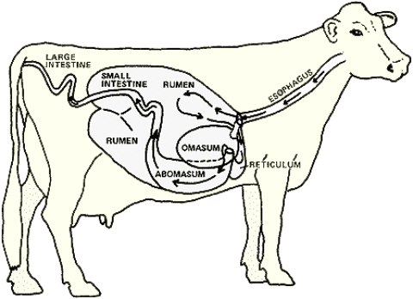
Cattle Digestive Tract

Slide 2
Carnivores, Herbivores & Omnivores
Carnivores: cats and dogs
Animals that normally consume animal tissue as main food source
Herbivores: Cattle, horses, sheep and goats
Primarily consume plants
Omnivores: Humans and pigs
Eat both plants and animal products
Carnivores and omnivores are monogastric animals, meaning they have simple stomachs. Only 1 stomach.
Ruminant Animals: complex stomachs, 4 compartments.

Slide 3
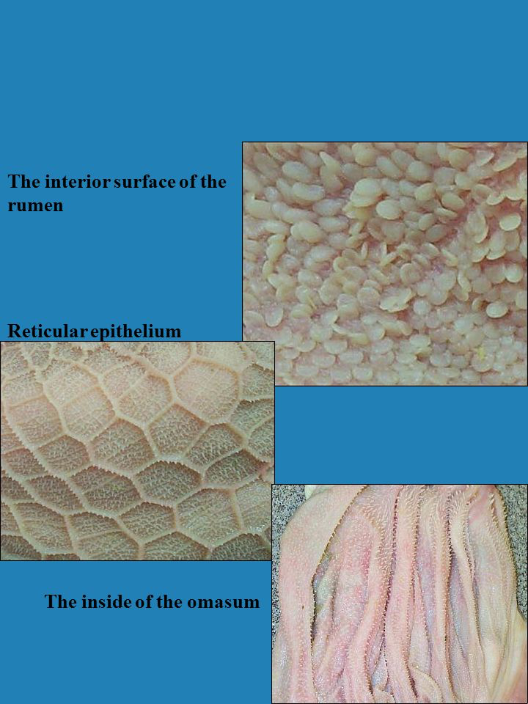
Ruminant Stomach Compartments
Esophagus
Rumen
Reticulum
Omasum
Abomasum
Small Intestines
Cecum
Large Intestines

Slide 4
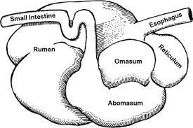
Esophagus
Food is passed from the mouth to the stomach by way of the Esophagus
Sphincter Valve at the junction of the stomach and esophagus that prevents feed from coming back up the esophagus.

Slide 5
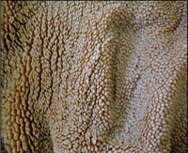
Rumen
First stomach in digestive tract
Largest of the stomachs: it can hold 25 gallons in a mature cow
Receives food from the esophagus
Large fermentation vat where billions of bacteria live and break down foods high in cellulose and foods down into protein
Lined with papillae; they increase the rumen’s surface area and amount it can absorb
Paunch

Slide 6
Ruminate
Chewing Cud
When a cow ruminates they are regurgitating food that they have already eaten and rechewing it.
Cows spend 35-40% of each day ruminating (chewing cud)

Slide 7
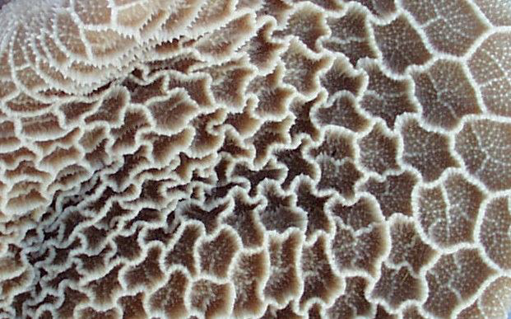
Reticulum
Second stomach in the digestive system
Pouch-like structure
It’s job is to store food and sort out foreign objects.
Tissues in the reticulum form a network similar to a honeycomb
Heavy/dense feed or metal objects eaten by a cow are dropped into this compartment
Nails or sharp objects can work there way into the tissue and cause hardware disease. Magnets can be used to prevent or surgery to treat.
Honeycomb

Slide 8
Omasum
Third stomach in the digestive system
A globe-shaped structure containing( like pages of a book)
It’s job is to absorb water/substance from what's been digested and break apart food
Strong, muscular walls help to break apart food
Manyplies

Slide 9
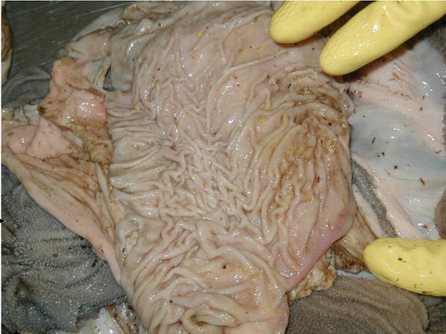
Abomasum
Forth stomach in the digestive tract
Only stomach that has glands
Glands release gastric juices that mix will food to help with the digestive process
Called the “true stomach” because it’s most like our
True Stomach

Slide 10
Small Intestine
Next is the digestive tract after stomachs
This is where most of absorption of nutrients and water occurs at this time.

Slide 11
Cecum
The cecum is where the small and large intestine meet
Undigested fiber is broken down here
The exact importance of the cecum is still unknown

Slide 12
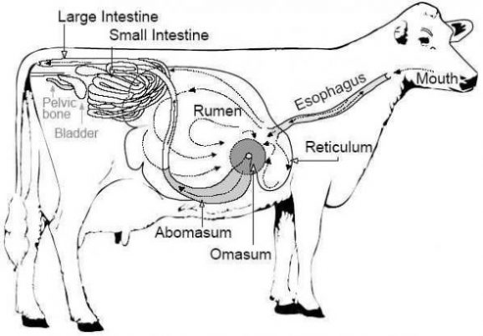
Large Intestine
Final organ in the digestive tract
Slow contractions occur to move along solid material.
They secrete mucus that binds colid material together

