Slide 1
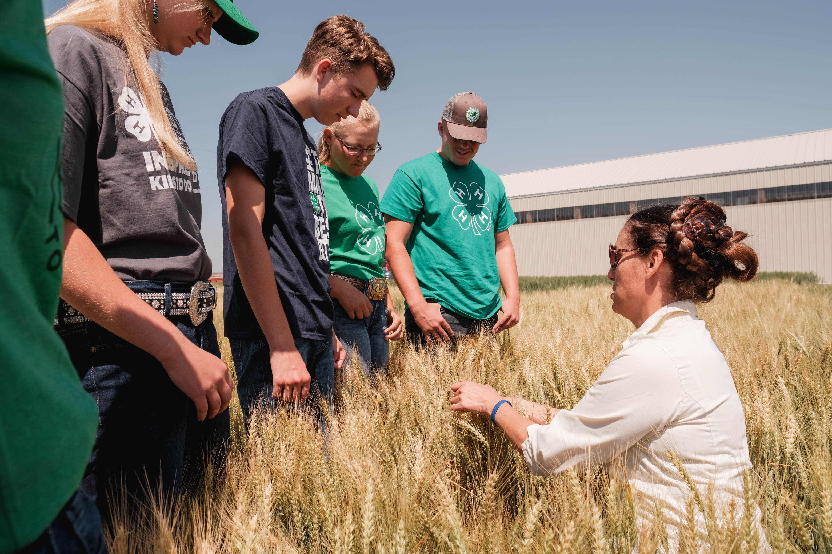


4-H CLUB & PROJECT LEADER TRAINING
GALLATIN COUNTY 4-H

Slide 2
AGENDA
1:00pm - 1:15pm
Meet Your Fellow Volunteers
1:15pm - 2:10pm
Club & Project Leader Expectations & Responsibilities
Resources & Tools
2:15pm - 3:10pm
Club & Project Financial Management & Fundraising
3:15pm
Project Leaders may leave at this time if they so choose. Club Leaders must stay until 4:00pm.
3:15pm - 4:00pm
Engaging 4-H Club Meetings & Meeting Structure

Slide 3

Meet Your Fellow Volunteers
GALLATIN COUNTY 4-H

Slide 4
4-H Leader Four Corners
How long have you been involved in 4-H?
  Less than 1 year
  1–3 years
  4–7 years
  8+ years

Slide 5
4-H Leader Four Corners
Pick your 4-H Superpower
  Organization
  Patience
  Creativity
  Problem-solving

Slide 6
4-H Leader Four Corners
Which describes your meeting prep?
  Planned weeks ahead
  Planned a few days ahead
  Planned the night before
  Planned while driving there

Slide 7
4-H Leader Four Corners
Complete the sentence: “A successful 4-H meeting is one where…”
  Everyone participates
  The youth are doing the talking
  We accomplish what we planned
  Everyone leaves excited for the next one

Slide 8
4-H Leader Four Corners
What is the hardest part about being a 4-H leader?
  Getting youth engaged
  Working with parents
  Managing time
  Handling difficult situations

Slide 9
4-H Leader Four Corners
Your biggest 4-H pet peeve
  Late arrivals
  No RSVPs
  “I didn’t know”
  Other favorite? Please share

Slide 10
4-H Leader Four Corners
Your fair-week personality
  “I have a schedule.”
  “Where is my kid?”
  “Who needs help?”
  “We’re just going to survive this.”

Slide 11
4-H Leader Four Corners
What do you hope youth remember about you?
  “They believed in me.”
  “They taught me something.”
  “They always encouraged me.”
  “They gave me opportunities.”

Slide 12
Think-Pair-Share
What is one thing you bring to our 4-H program?

Slide 13
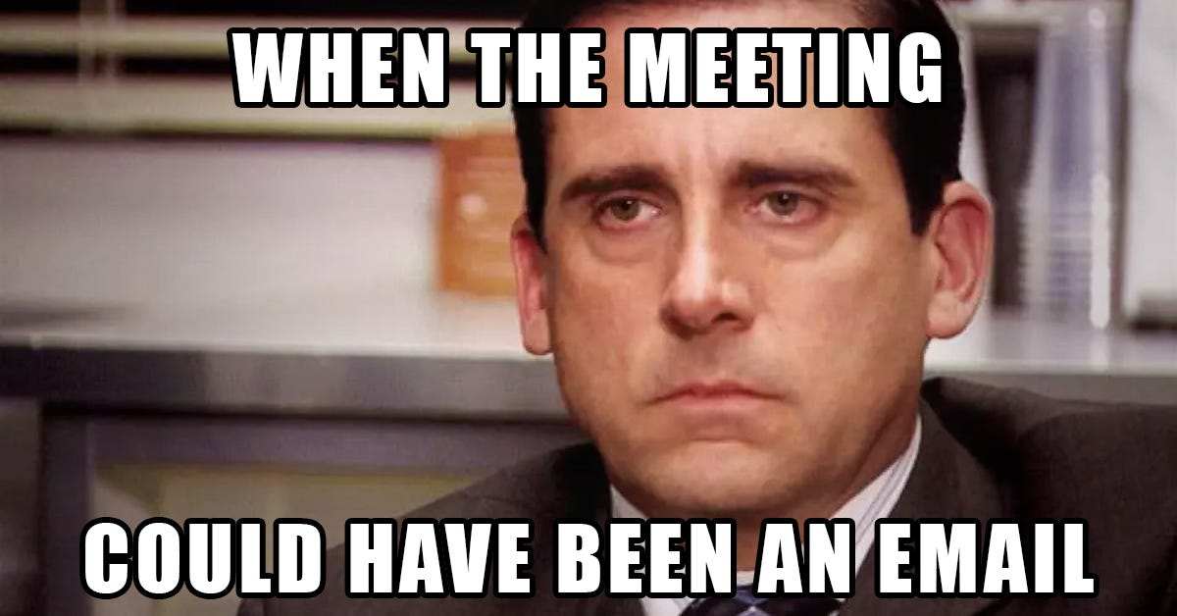
Oh wait...it was

Slide 14


650+ Youth Members
140 Volunteers
2.5 Staff

Slide 15
650+ Youth Members
250+ on average “Members at Large”
478 youth in Animal Projects
208 youth in Shooting Sports
11 Clubs
~ 40 Projects w/ Leaders
140 Volunteers
2.5 Staff
40 hrs/week (contracted)

Slide 16
Occurance
Concern/Issue/Result
Challenge #1
Welcome
The office spends months reminding individuals to complete enrollment. Volunteers are organizing activities without being enrolled. Animals are being tagged when the youth is not enrolled in the project. Exceptions are requested after deadlines have passed. Additional reminder emails = additional staff time.
Enrollment Isn’t Completed
Challenge #1
Welcome
Leaders aren’t using their most up-to-date roster. Newsletter blurbs aren’t submitted. The office doesn’t know what clubs are doing or when they are meeting. Families become frustrated by inconsistent or missing communication. Families miss meetings, activities, or deadlines. Families may disengage or drop out of the program.
Families reaching out to Office more frequently with questions
Facility requests aren’t submitted Properly
The office ‘loses’ the communication and the facility isn’t booked. A leader communicates a date, time, or location to families before the facility is confirmed. The office has to contact the leader to change the plans. Families receive conflicting information.
Challenge #1
Welcome
Challenge #1
Welcome
An unapproved fundraising method is used. Incorrect logos or branding may be used. Activities may involve circumstances that create risk-management concerns. The office has to react instead of being able to support and plan proactively.
Finding out about fundraisers on social media
Increased frequency of after-hours and weekend communications
Information was probably already in an email, on BAND, in a Newsletter, printed on a monthly meeting agenda, on Facebook, at a leader training that was offered but not attended, etc. Is it an emergency? Or is it just easier to text/call. No boundaries. No disconnect time.
Challenge #1
Welcome
Increased frequency of rule exceptions, complaints about fairness, unclear or inconsistent expectations
Expectations aren’t discussed with youth/families at meetings or workshops. Rules are interpreted differently by different leaders. Increased complaints and questions about fairness. More staff time spent mediating individual situations. Additional rules are created to prevent specific situations from happening again.
Challenge #1
Welcome

Slide 17


Slide 18


Slide 19

Club & Project Leader
Expectations & Responsibilities
GALLATIN COUNTY 4-H

Slide 20

Volunteer Enrollment
What is required to be a volunteer?
    Annual application/enrollment online through ZSuite
    Background check (first year only or if lapsed)
    $10 annual fee
    Clover Academy Orientation modules (if applicable)
MUST be enrolled, background checked & paid to be considered ACTIVE (i.e certified, insured and allowed to conduct meetings/events with youth)
Acknowledgement & abide by:
  Volunteer Code of Conduct
  Family Code of Conduct

Slide 21



CLUB LEADERS VS PROJECT LEADERS
CLUB
PROJECT
  Coordinate and plan business meetings
  Help club members set annual goals and plan the yearly program of activities
  Coach officers
  Connect families, projects & Extension
  Focus on community service, outreach & engagement
BOTH
  Build subject-matter skills
  Plan hands-on experiences
  Help members establish goals and plan their project work
  Use curriculum and record books to record, challenge, enhance learning experiences
  Connect with subject-matter experts for content and career possibilities
Communicate with the Office
Track Participation
Financial Management
Record Books
Risk Management
Personal & Professional Development
WE'RE DEVELOPING THE MEMBER - NOT JUST THE CLUB/PROJECT.

Slide 22

Planning & Risk Management
Locations
  Google Form for Extension Office and Fairgrounds
    Request versus confirmed
  Accessible and safe
  Rental contract procedure
Insurance/Activities
  Certificate of Insurance for meeting locations (if requested by facility)
  Process in an Emergency & Incident Reports
  American Income Life Insurance *high risk
Chaperoning
  Certified Volunteer
  No dictating who rides with who
Safety & Accomodations
  Door Code/After Hours
  Waivers (media release, disabilities, authorization to treat)

Slide 23


Communication is KEY
Rosters, Email. BAND, Calendars, Other tools?
COMMUNICATION
Don’t wait until the last minute to communicate with your families.
CC the 4-H Office on communications.
Don’t assume everyone knows everything.
Have clear and consistent communication methods.
Don’t only rely on email (i.e. not submitting to the Newsletter)
Respond to families in a reasonable timeframe.
Don’t react or respond without thinking.
Communicate with all necessary parties.
Allow people to overstep communication boundaries and timefames
Utilize communication methods appropriate to the situation/need

Slide 24

Keeping 4-H the Focus
4-H is more than just “classes” - it is a Youth Development Program
"To Make the Best Better"

Slide 25

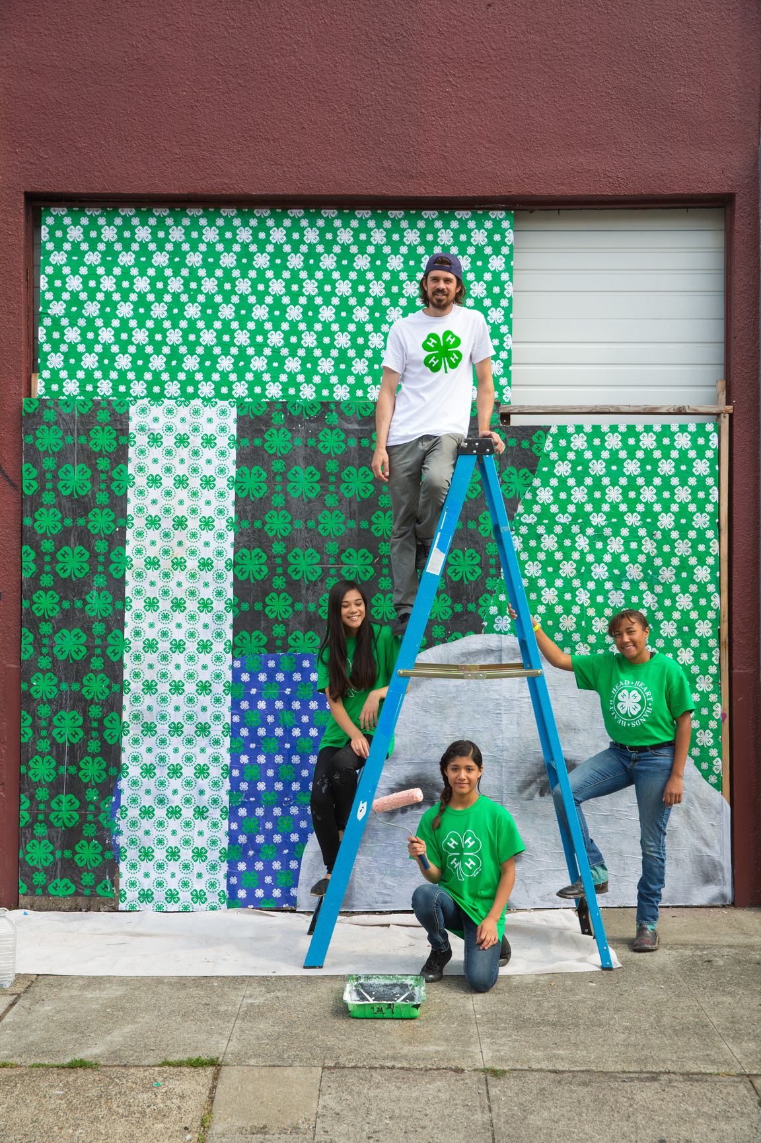
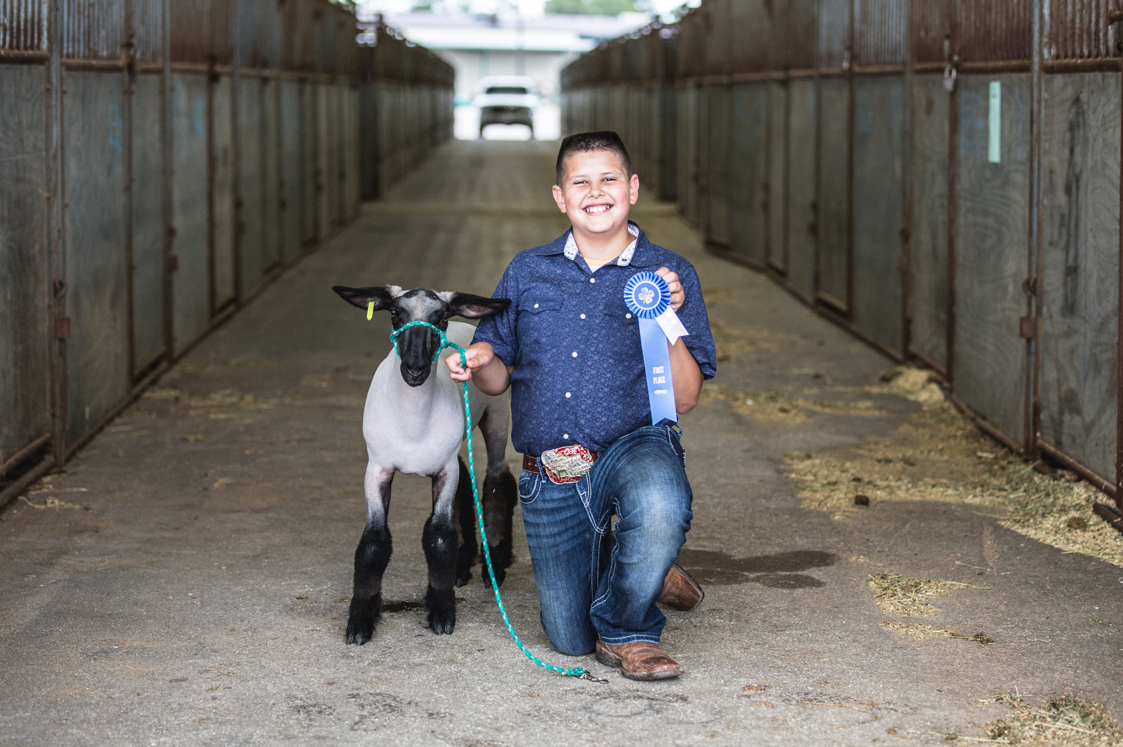
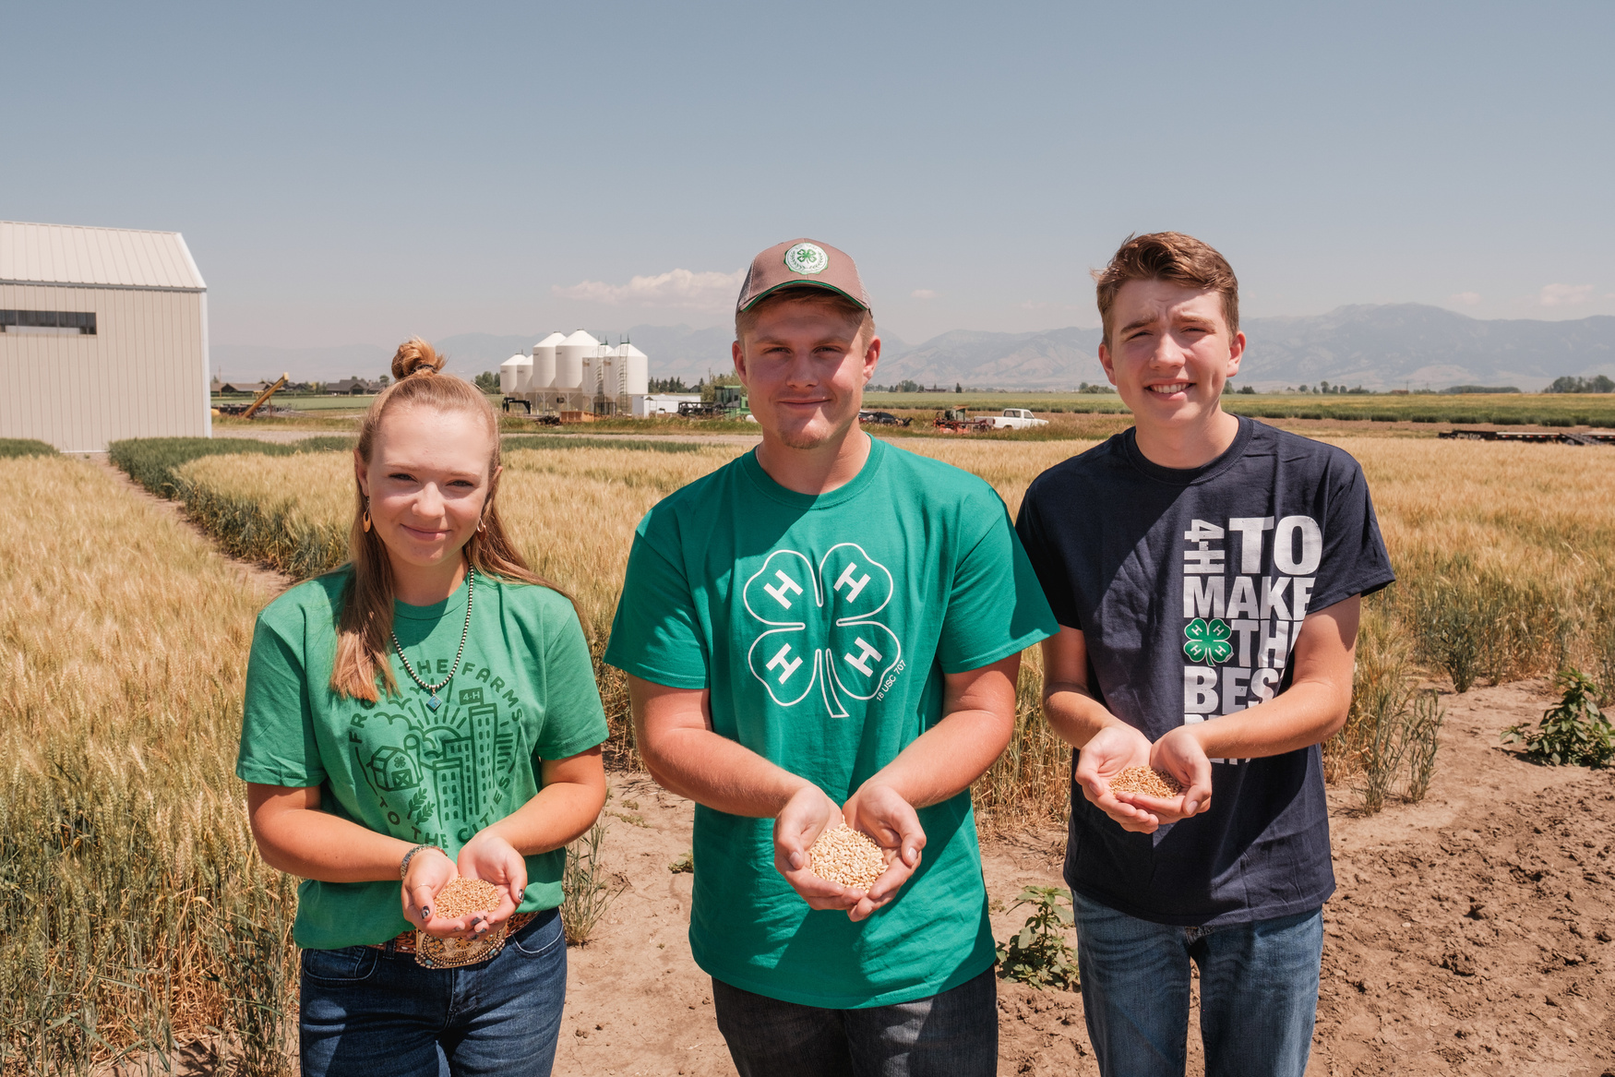
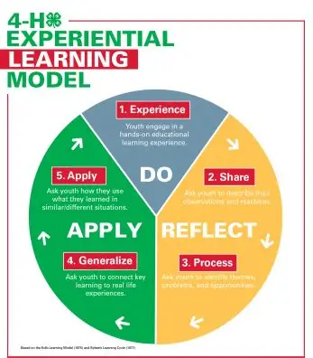
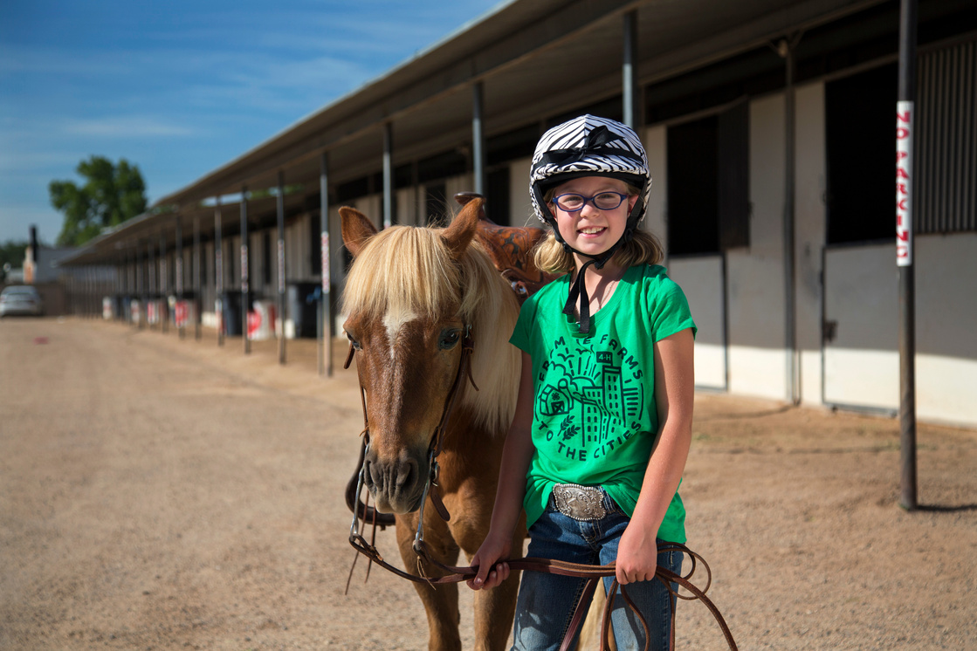
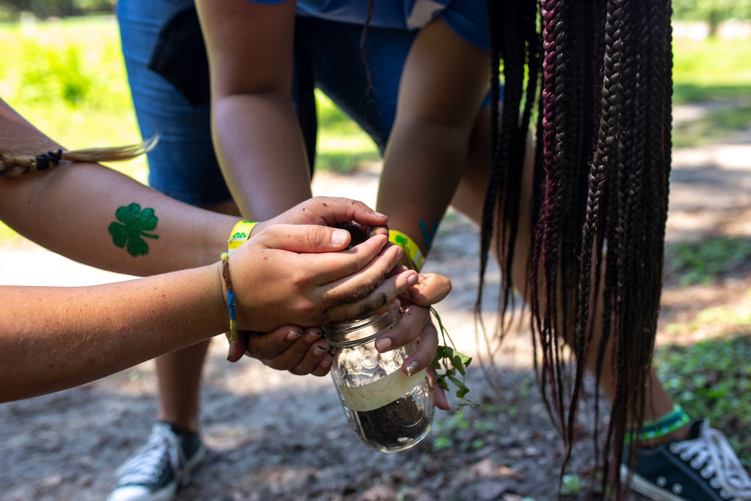
Opportunities
For Development
  Roll Call
  Belonging
  Connections/Careers
For Leadership
  Peer-to-peer instruction
  Mentorship
  Youth voice
For Improvement
  Welcome feedback
  Change it up
  Reflect

Slide 26


WHAT DOES "LEADING 4-H WELL" LOOK LIKE?
It's more than running meetings and completing projects.
Safe
Inclusive
Educational
Youth-Focused
Leader-Supported
Protect Youth
Create belonging
Make it meaningful
Meet them where they’re at
Coach, don’t control
Share an example of how you’ve led well in one of the above areas?

Slide 27
Resources & Tools
GALLATIN COUNTY 4-H

Slide 28


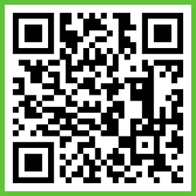



Where to Find 4-H Information
Gallatin County 4-H Website
  Forms and Documents, Newsletter, Online enrollment, Record Books
Email Listserv
  Enrolling on ZSuite auto-adds you to our listserv
  Reminders, announcements, newsletter, opportunities, deadlines
Monthly Newsletter
  Monthly 4-H Newsletter with all the information you will need to stay in the loop with 4-H activities, events and opportunities.
BAND App
Facebook & Instagram

Slide 29
Where to Find 4-H Resources
Montana 4-H Website
  Forms and Documents, Newsletter, Online enrollment, Record Books
  Policies
  State & National Events
The QUAD
  The Quad is an online platform that brings together professional development, youth learning, curated resources, and professional networking and collaboration in one streamlined platform.
Online
  Find research-based, or tried-and-true, activities
  Extension resources from other states (Ohio, Idaho, Michigan, Texas, Kansas, Georgia)
  Facebook groups
Community Network
  Fellow Club/Project leaders
  Businesses/Organizations
  Parents, individuals

Slide 30
Did You Know?
The Gallatin 4-H Office has the following items for your use:
  Canva Pro subscription
  SignUp Genius pro subscription
  Kahoot subscription
  Projector screens
  Projectors
  Extension cords
  Power strips
  Two PA systems with microphones
  Folding tables
  Pop-Up Canopy tents
  An abundance of craft supplies
  Ipads
  Laptops
  Cotton Candy Machine
  T-shirt Press
  Education kits
**Use is a privilege

Slide 31


Slide 32
Club & Project
Financial Management & Fundraising
GALLATIN COUNTY 4-H

Slide 33

4-H Money is 4-H Money
4-H money belongs to 4-H, not the leader, not a family, not an individual
ACCOUNTABILITY
TRANSPARENCY
YOUTH
INVOLVEMENT
We can explain every dollar.
Members and families can understand the finances.
Money management can teach life skills.

Slide 34


Document, Document, Document!
Follow the money from beginning to end
RECEIVE
RECORD
DEPOSIT
SPEND
DOCUMENT
RECORD
Receipts • Treasurer Reports • Approvals • Meeting Minutes • Reconciliations • Annual Reporting
DEPOSIT
Notes:
Basically CYA
Participation approvals within Club resulting in payment from side account will need to email the office with a list of names, it is too confusing and too much work to know who is in your club receiving financial support

Slide 35


Financial Request
These funds aim to grow Gallatin County 4-H by supporting expenses associated with camps, workshops, training, money for projects, etc. Please note that your request may be funded in full or in part, depending on the funds available. We do request that each individual complete a form to be considered for funding. This form must be submitted PRIOR to the event occurring!
Forms
GALLATIN COUNTY 4-H
ALL INCLUDED IN YOUR “TOOL KIT”
Reimbursement Form
Sometimes you need to spend a little money to have fun or create a hands-on learning activity with your club or project. To request reimbursement for your expenses you must fill out the form and attach receipts. Clubs and projects with possession of their own money will have a similar process. You must also have an available balance in your side account to receive a reimbursement.
Fundraising Request
If your 4-H club or project is planning to participate in any fundraising activity it is necessary to notify the Gallatin County Extension office of your intention. Please complete the following form and turn it into the Gallatin County Extension office two weeks prior to the fundraising event or prior to soliciting donations. Guidelines for 4-H Fundraisers can be found in the Gallatin County 4-H Policy and Procedures manual.

Slide 36
IRS
What is a 501c3
The 501c3 category is a Non-Profit Tax bracket. (Gallatin CO 4-H's 501c3: ULC, Gallatin County Foundation, Market Livestock, most clubs)
Filing 990 annually
To keep your 501(c) (3) status, you must file a 990 annually. The State 4-H Center has taken over the filing portion since we are under their tax umbrella.
1% Forms
Montana 4-H Center requires all clubs and projects to submit a Financial review form at the end of each fiscal year, and pay 1% of their account balance to support state programs.

Slide 37


Year End Reporting, IRS Tax Filings & External Bank Accounts
Accountability and Transparency
EXTERNAL BANK ACCOUNTS
SIDE ACCOUNTS
Leader Sends Completed Year-End Financial Reports & 1% Forms to Office with 1% Fee Payment
Office Completes Year-End Financial Reports & 1% Forms
Must use Club EIN number not a personal SS Number
Office Submits Year End Information to State Office with ALL 1% Fees
The 4-H Extension Agent (Molly) should be added to ALL accounts.
Club/Committee is required to submit monthly statements to office.
Year-End Reporting is Complete when ALL signatures have been completed.
Club Leaders receive emails for their e-signatures

Slide 38
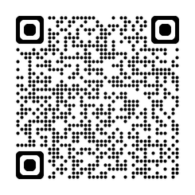

Why do we fundraise?
Program Support:
Fundraisers help cover the costs of the many programs and activities that make 4-H so impactful. This includes purchasing supplies for science experiments, art projects, agricultural activities, and more. Without fundraising, many of these valuable programs would not be possible.
Youth Development Opportunities:
Fundraising allows us to offer scholarships, grants, and financial assistance to 4-H members. This ensures that all youth, regardless of their financial situation, can participate fully in 4-H and take advantage of its opportunities. Jr. Rec Lab, State Rec Lab, 4-H Summer Camp, 4-H Congress
Community Engagement:
Fundraising events are more than just a way to raise money; they are also a way to engage with the community. These events help raise awareness about 4-H, build community support, and foster a sense of unity and involvement among members, volunteers, and supporters.
Enhanced Experiences:
The funds raised go towards enhancing the 4-H experience for all members. This can include funding for field trips, special guest speakers, and other enrichment activities that provide valuable learning experiences.
Volunteer Support: Fundraisers help cover the cost of essential volunteer background screenings, ensuring a safe and supportive environment for our youth. They also provide funds for basic club supplies, which are necessary for the smooth operation of club meetings and activities.
Recognition and Celebration: Fundraising helps pay for events like the annual awards banquet, where we celebrate the achievements of our 4-H members and volunteers. This recognition is important for motivation and morale, highlighting the hard work and dedication of everyone involved.
Sustainability: Consistent fundraising efforts ensure the long-term sustainability of 4-H programs. By generating funds regularly, we can plan ahead, expand our programs, and continue to provide high-quality experiences for our members year after year.
Popa. (2024). Re: University of Florida Extension Service Blogs: Why Do We Have These Fundraisers?

Slide 39

FINANCIAL
WIZARDRY
START

Slide 40





PLAYERS
Heads -
Finger Snappers
Hearts - Table Smackers
Hands -
Hand
Clappers
Health -
Foot Stompers
Clovers -
Soft Whistlers

Slide 41
HOW TO PLAY
There are 3 different types of games!
Answer the question
Multiple choice
True or false
Red Flag
Green Flag

Slide 42
1
A leader pays $75 out of pocket for club/project supplies. What should they do?
ANSWER THE QUESTION

Slide 43
ANSWER
Submit receipts and completed reimbursement form to office or club treasurer within 30 days.

Slide 44


2
A leader bought treats for the meeting and told the treasurer/office they spent $42.
RED FLAG
GREEN FLAG

Slide 45
Documentation!
A receipt is needed to have accountability and transparency.
RED FLAG

Slide 46
3
Using your personal Venmo for Club/Projects is fine:
TRUE
FALSE

Slide 47
Using your personal Venmo opens you up for liabilty and puts you at financial risk.
TRUE
FALSE

Slide 48
4
Ways to use your club/project money:
A. MEMBER SUPPORT
B. COMMUNITY SUPPORT
C. CLUB PIZZA PARTY
D. ALL OF THE ABOVE

Slide 49
Ways to use your club/project money:
A. MEMBER SUPPORT
B. COMMUNITY SUPPORT
C. CLUB PIZZA PARTY
D. ALL OF THE ABOVE

Slide 50
5
What are three words that describe good financial management?

Slide 51
ANSWER
Accountablility, transparency, accuracy, responsibilty, documentation, consistency

Slide 52
6
Youth Treasurer’s report:
Check written to Leader’s spouse for $800
Memo - Christmas Party
RED FLAG
GREEN FLAG

Slide 53
Documents and reporting/recording and transparency!
RED FLAG

Slide 54
7
Ways to use club/project money on members:
A. MEMBER SUPPORT
B. CLUB ENHANCEMENTS
C. MEMBER DEVELOPMENT
D. BUCKLES/PRIZES

Slide 55
All of the above is acceptable. We tend to focus on Buckles/Prizes too often when that is not the purpose of 4-H.
A. MEMBER SUPPORT
B. CLUB ENHANCEMENTS
C. MEMBER DEVELOPMENT
D. BUCKLES/PRIZES

Slide 56
8
Financial Records should be understandable to someone who wasn’t involved in the transaction.
TRUE
FALSE

Slide 57
Financial Records should be understandable to someone who wasn’t involved in the transaction.
TRUE
FALSE

Slide 58
9
You have a youth who is interested in participating in a 4-H event (or an outside 4-H event, but project related) and can not financially afford it. How can you help?

Slide 59
As a club or project committee discuss financially supporting this member before sending them the ULC to ask for assistance.
Submit meeting minutes (including discussion, motions and voting) AND which members will be receiving this support.

Slide 60
Congratulations!
You are a Financial Wizard!

Slide 61
Reflection
What is one area of improvement you want to tackle as a Leader this 4-H Year?
Share it with another leader. Write it down to hold yourself accountable.

Slide 62
BREAK

Slide 63
Engaging 4-H Club Meetings
& Meeting Structure
GALLATIN COUNTY 4-H

Slide 64
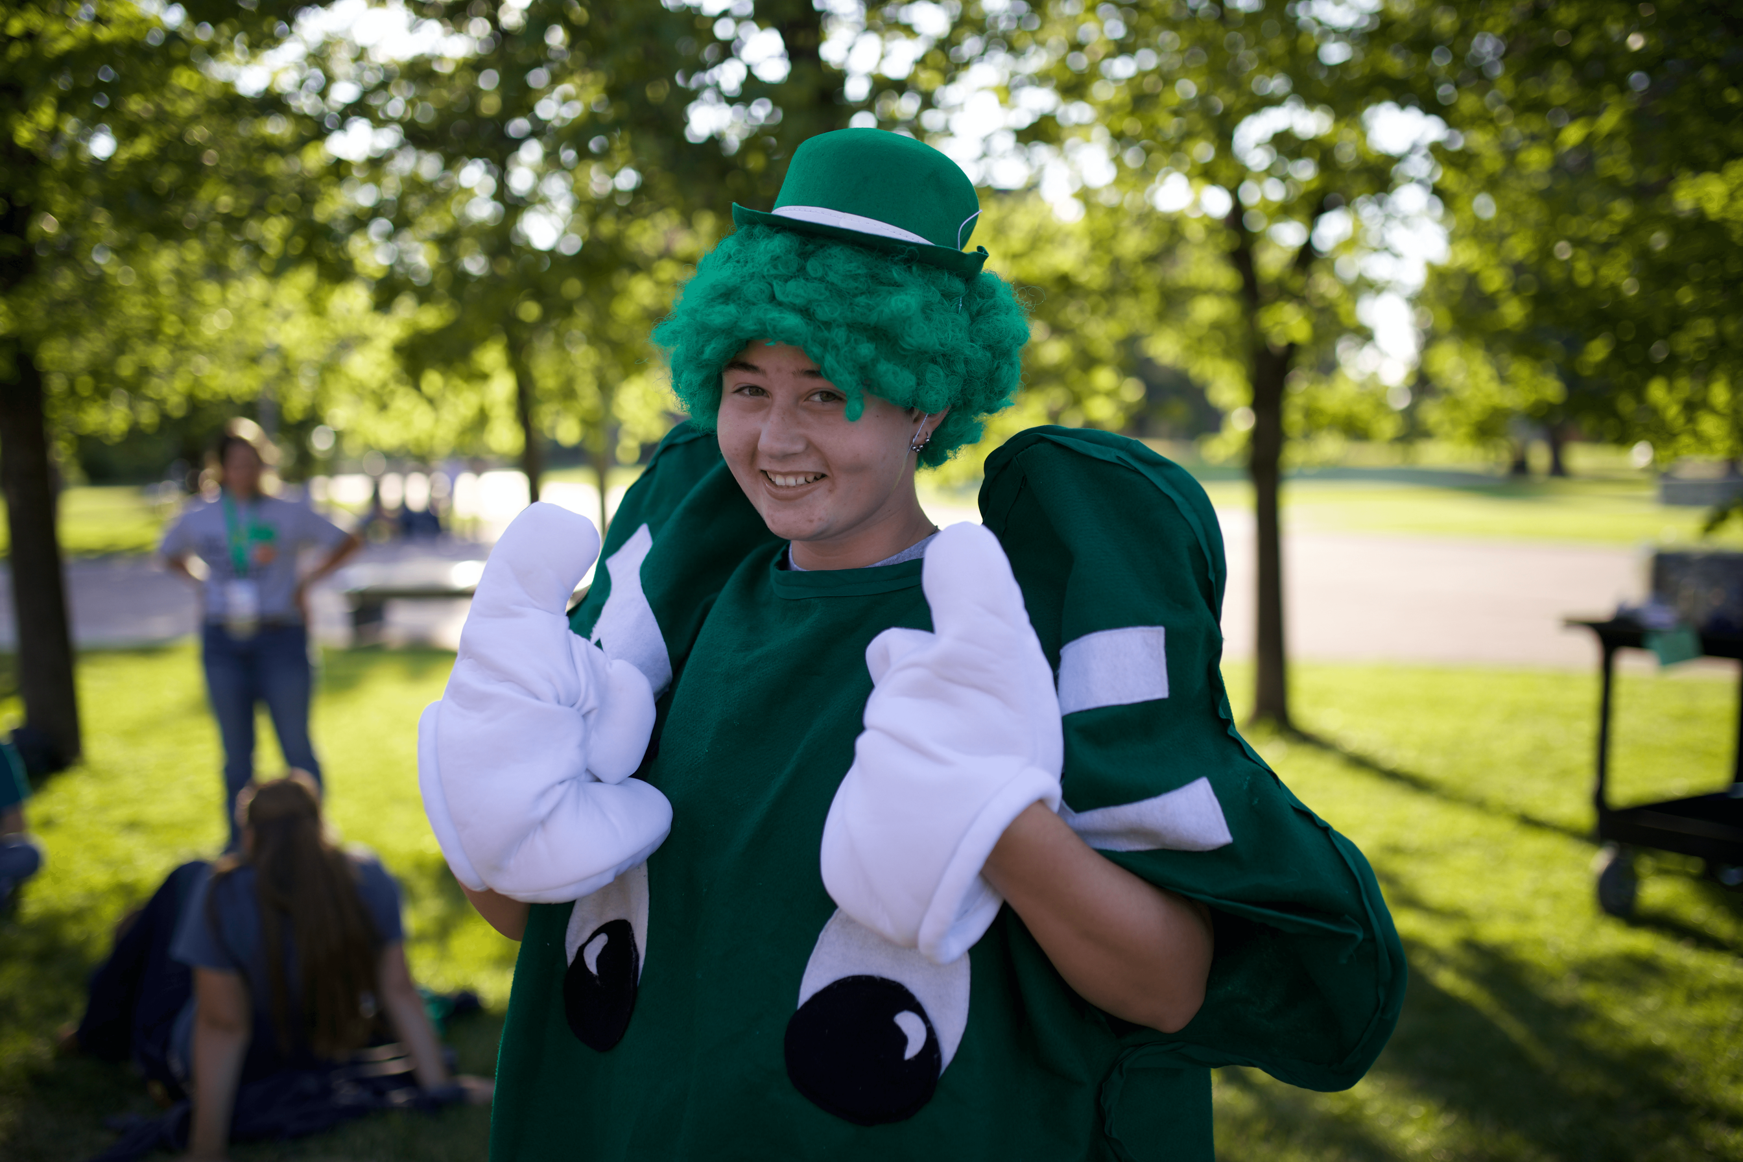
Why Clubs Matter
  Connection to the 4-H mission
  Hub for information
  Collaboration
  Relationships & Belonging
  Community impact
  Public Speaking
  Educational beyond projects
  Citizenship
What benefit is the member getting out of participating in a Club vs. Member at Large?

Slide 65
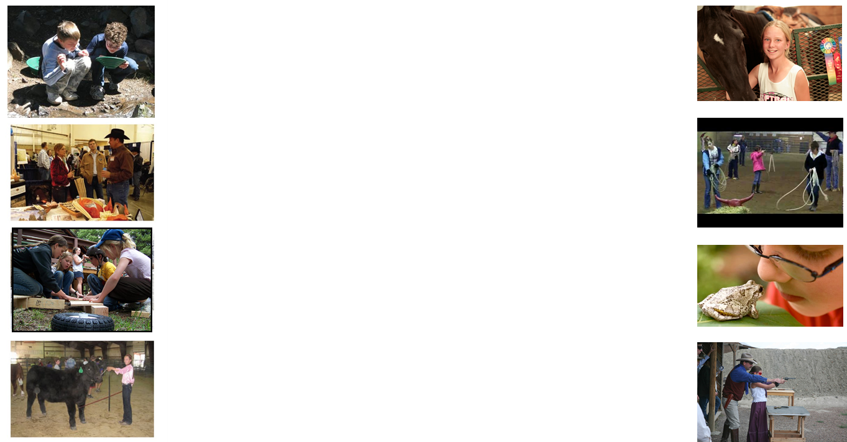
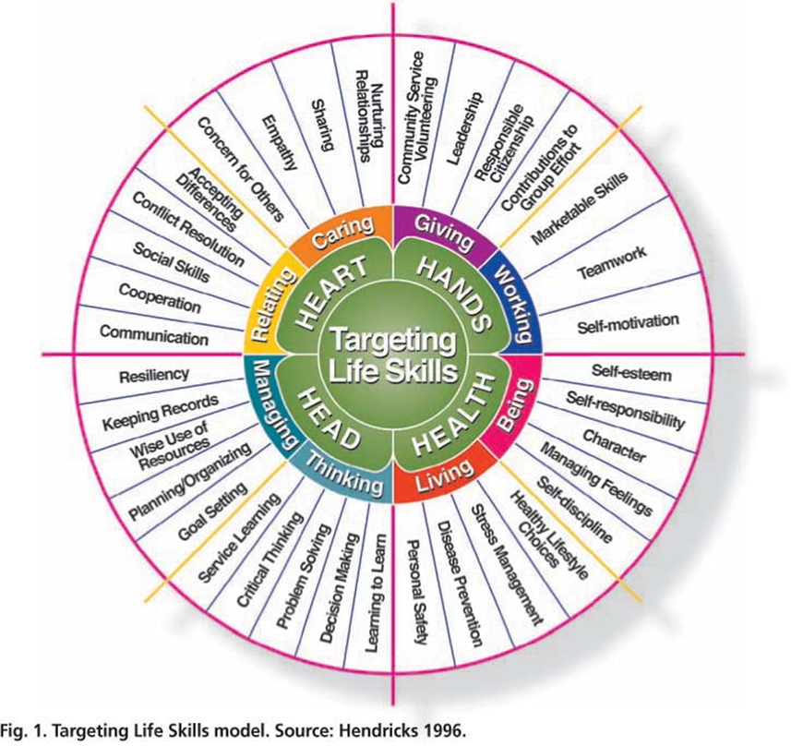

Slide 66
DON'T JUST DO THE ACTIVITY
Help members discover what they learned.
DO AGAIN
↻
DO
HOW CAN I USE IT?
WHAT HAPPENED?
WHY?

Slide 67

Leaders are Coaches - not CEOs
Youth need responsibility in order to develop responsibility.
Ask
Guide
Support
Step Back
Don't take away a youth's opportunity to struggle productively.

Slide 68
TURN ACTIVITIES INTO LEARNING
INSTEAD OF...
ASK:
What worked?
Did everyone have fun?
What was difficult?
Onto the next thing....
What would you change?
What did your team do well?
See you next month!
How did you contribute?
Where could you use this skill again?

Slide 69
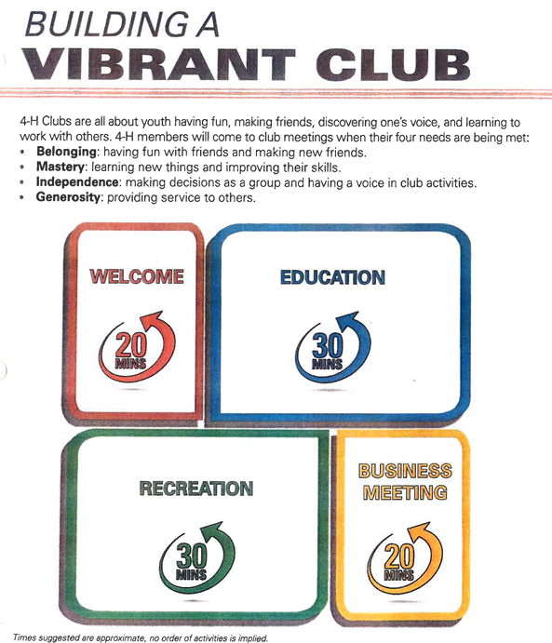

Slide 70
Think-Pair-Share
What is something you’ve done at your Club that you’re proud of?

Slide 71
Creating Your Club Structure
  Role Call
  Roles of Officers
    How will they help YOU
    Responsibilities/Jobs
  Club Committees & Adult Helpers
  Education
  Recreation
  Fundraising/Service
  Annual Calendar

Slide 72
Build the Ultimate 4-H Meeting
Challenge

Slide 73
4-H CLUB MEETING
Challenge
Challenge #1
Welcome
Create an icebreaker that gets even the quietest of members to participate.

Slide 74
4-H CLUB MEETING
Challenge
Challenge #1
Welcome
Create an icebreaker that gets even the quietest of members to participate.
Challenge #2
Youth Involvement
Provide opportunities where members can take leadership roles. Give at least 3 members specific jobs.

Slide 75
4-H CLUB MEETING
Challenge
Challenge #1
Welcome
Create an icebreaker that gets even the quietest of members to participate.
Challenge #2
Youth Involvement
Provide opportunities where members can take leadership roles. Give at least 3 members specific jobs.
Challenge #3
Business Meeting
Determine one Club initiative that would need to be discussed/voted upon during the Business Meeting. Come up with 2 ways youth could contribute to the discussion in an interactive way.

Slide 76
4-H CLUB MEETING
Challenge
Challenge #1
Welcome
Create an icebreaker that gets even the quietest of members to participate.
Challenge #2
Youth Involvement
Provide opportunities where members can take leadership roles. Give at least 3 members specific jobs.
Challenge #3
Business Meeting
Determine one Club initiative that would need to be discussed/voted upon during the Business Meeting. Come up with 2 ways youth could contribute to the discussion in an interactive way.
Challenge #4
Educational Content
Come up with a potential educational topic/presentation that you could bring in to your Club that would include 3 different life skills (using life skill wheel).

Slide 78
4-H CLUB MEETING
Challenge
Challenge #1
Welcome
Create an icebreaker that gets even the quietest of members to participate.
Challenge #2
Youth Involvement
Provide opportunities where members can take leadership roles. Give at least 3 members specific jobs.
Challenge #3
Business Meeting
Determine one Club initiative that would need to be discussed/voted upon during the Business Meeting. Come up with 2 ways youth could contribute to the discussion in an interactive way.
Challenge #4
Educational Content
Come up with a potential educational topic/presentation that you could bring in to your Club that would include 3 different life skills (using life skill wheel).
Challenge #5
Recreation/Service
Create a service or citizenship activity that youth can participate in that includes Movement, Interaction and Fun!

Slide 79
Reflection
What is one thing you plan to change this year that gives members more ownership of their 4-H experience?
Share it with another leader. Write it down to hold yourself accountable.

Slide 80
Mark Your Calendars
Gallatin County 4-H Adult Winter Series
Wednesdays 6pm-8pm
  January 13
  January 20
  January 27
  February 3
What topics do you want to see?!

