Slide 1
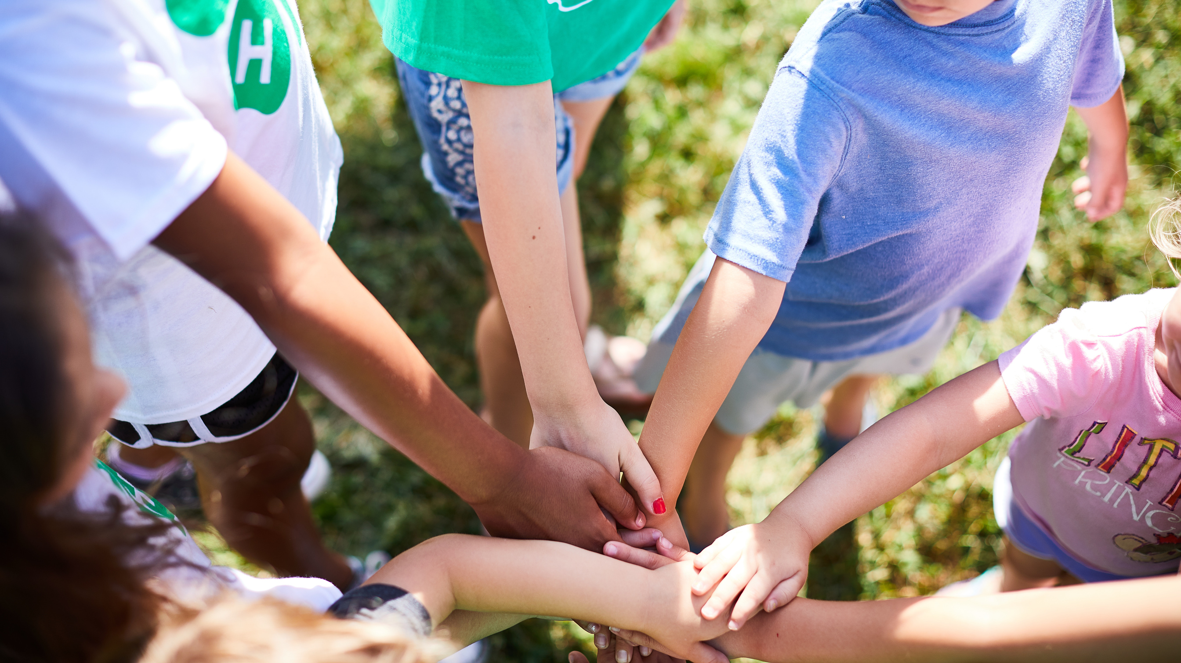


Join
Gallatin County 4-H
2026-2027

Slide 2


Extension & 4-H
MONTANA STATE UNIVERSITY - LAND GRANT COLLEGE
  A land-grant college or university is an institution that has been designated by its state legislature or Congress to receive the benefits of the Morrill Acts of 1862 and 1890. At least one land-grant institution per state.
  The original mission was to teach agriculture, military tactics, and the mechanic arts so members of the working classes could obtain a liberal, practical education.
MSU COOPERATIVE EXTENSION SERVICE
  To disseminate information gleaned from the experiment stations’ research, the Smith-Lever Act of 1914 created a Cooperative Extension Service associated with each land-grant institution
  Mandated for openness, accessibility, and service to people, and many of these institutions have joined the ranks of the nation’s most distinguished public research universities
4-H YOUTH DEVELOPMENT PROGRAM
  Youth education sector of the land-grant college and Extension service
  Opportunity for all!

Slide 3
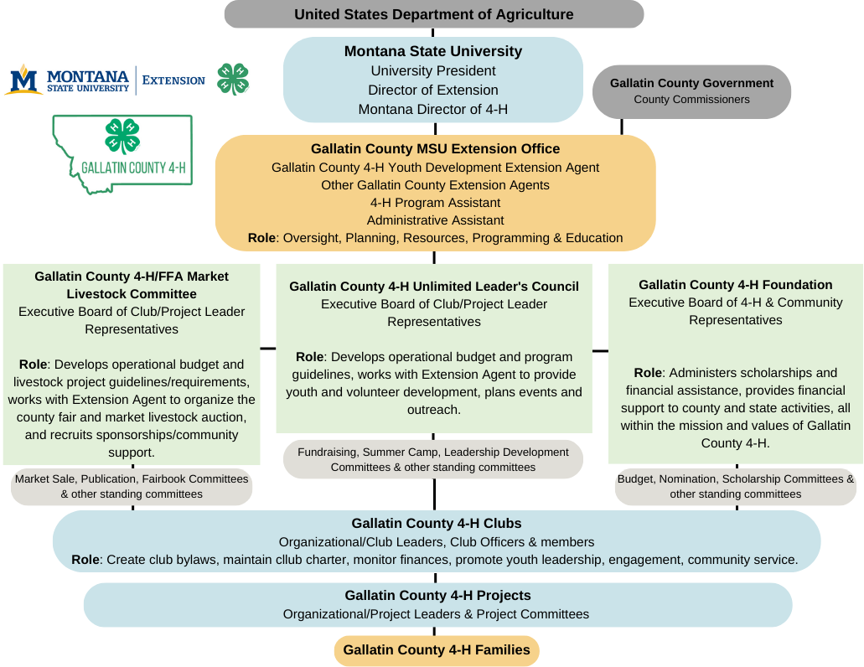

Slide 4

The Basics of 4-H

Slide 5
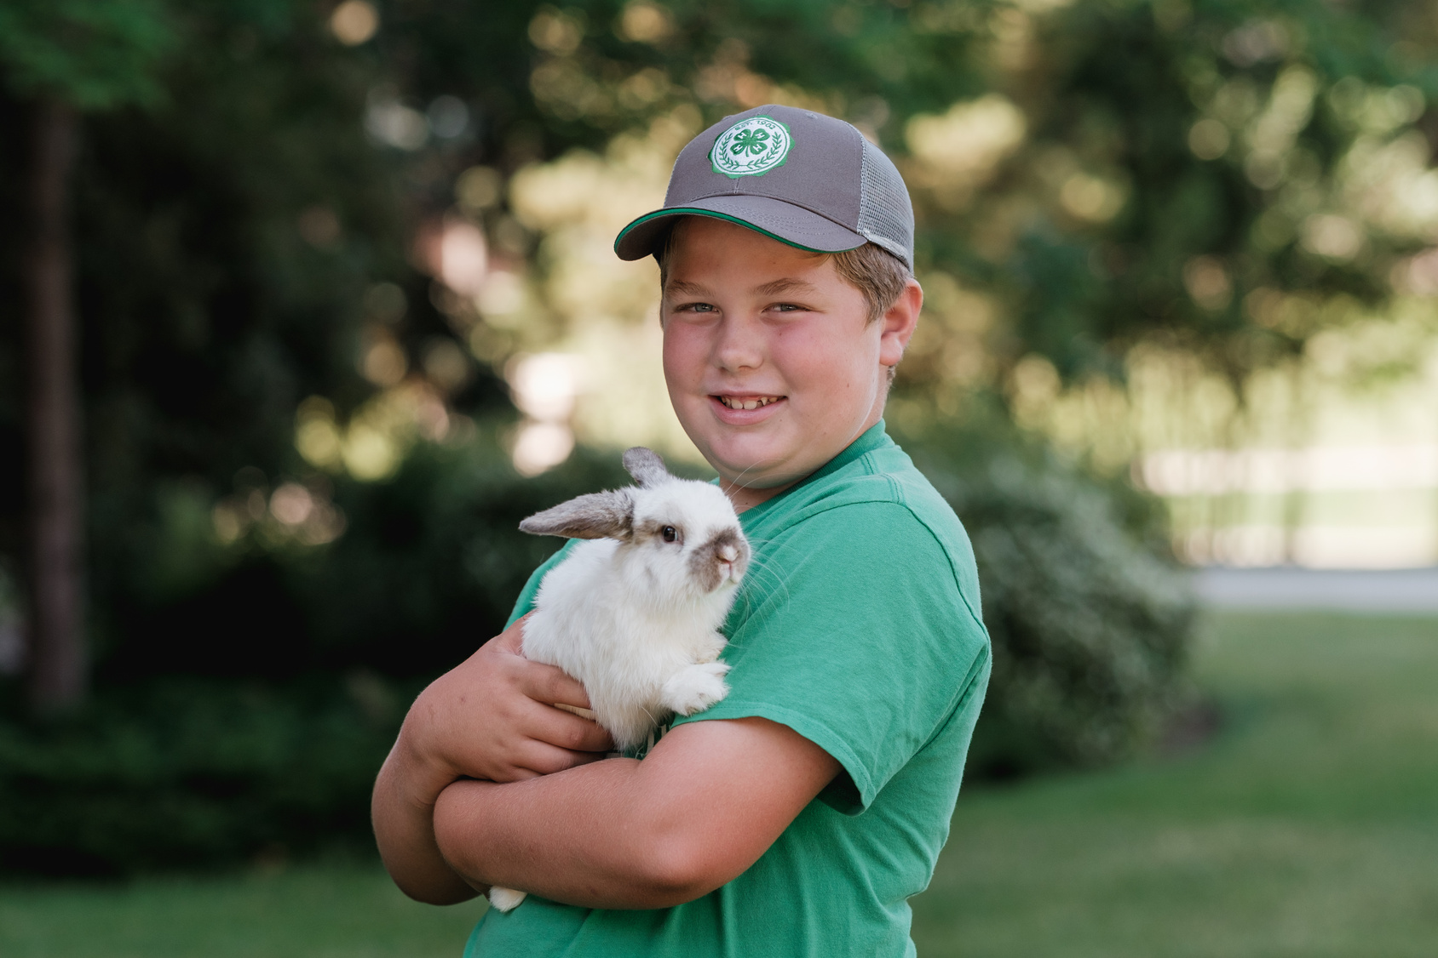



What is 4-H?
Motto: "To make the best better"
  Montana 4-H is the youth development program of Montana State University
  4-H is the largest, out-of-school youth development program in the state, reaching over 14,000 youth in all 56 counties and 7 tribal reservations
  Mission: 4-H empowers youth to reach their full potential, working and learning in partnership with caring adults
  4-H offers more than 200 different projects and learning experiences
4 Hs': Head, Heart, Hands, and Health

Slide 6
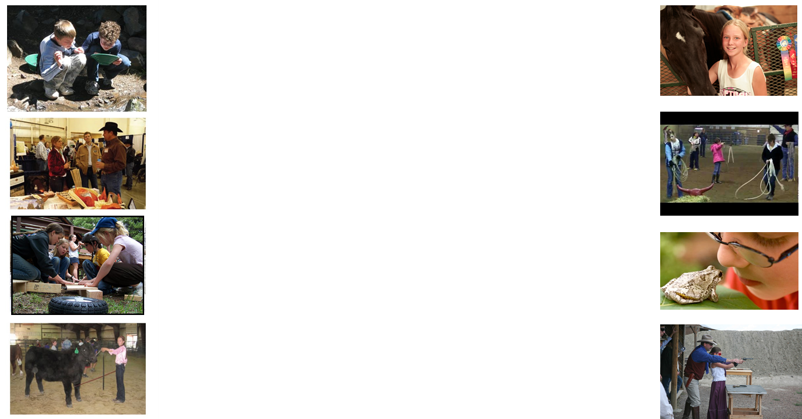
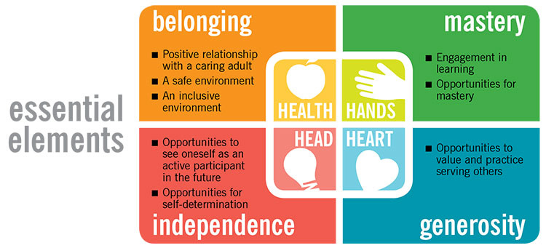

Slide 7
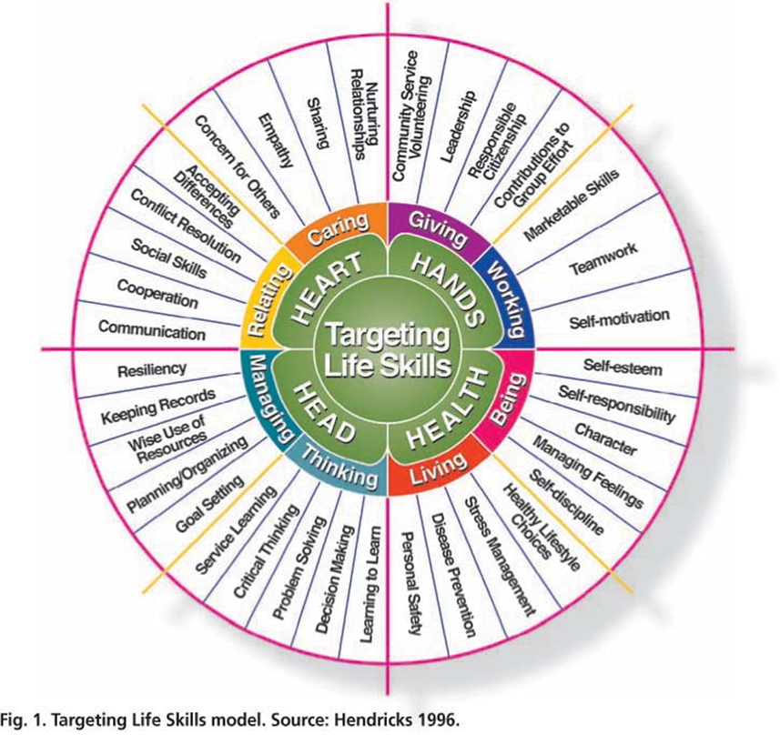

Slide 8
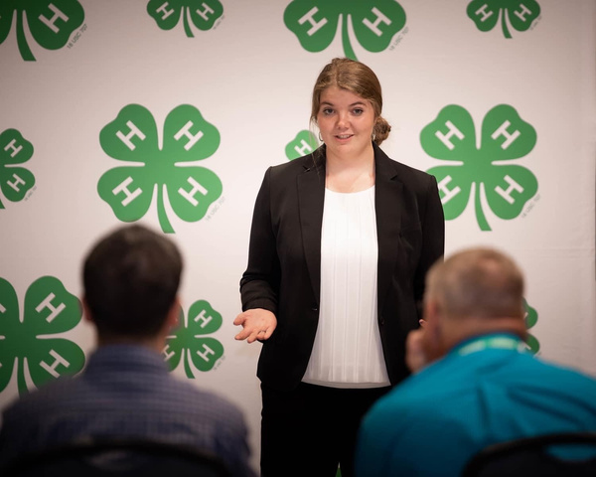
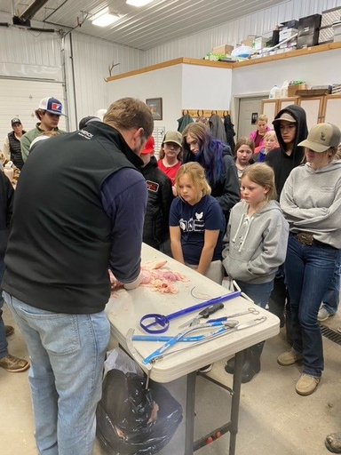
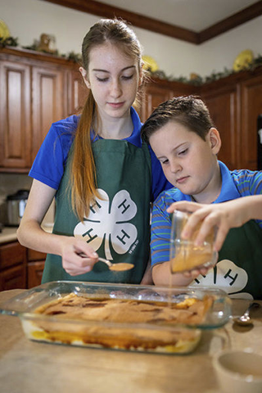
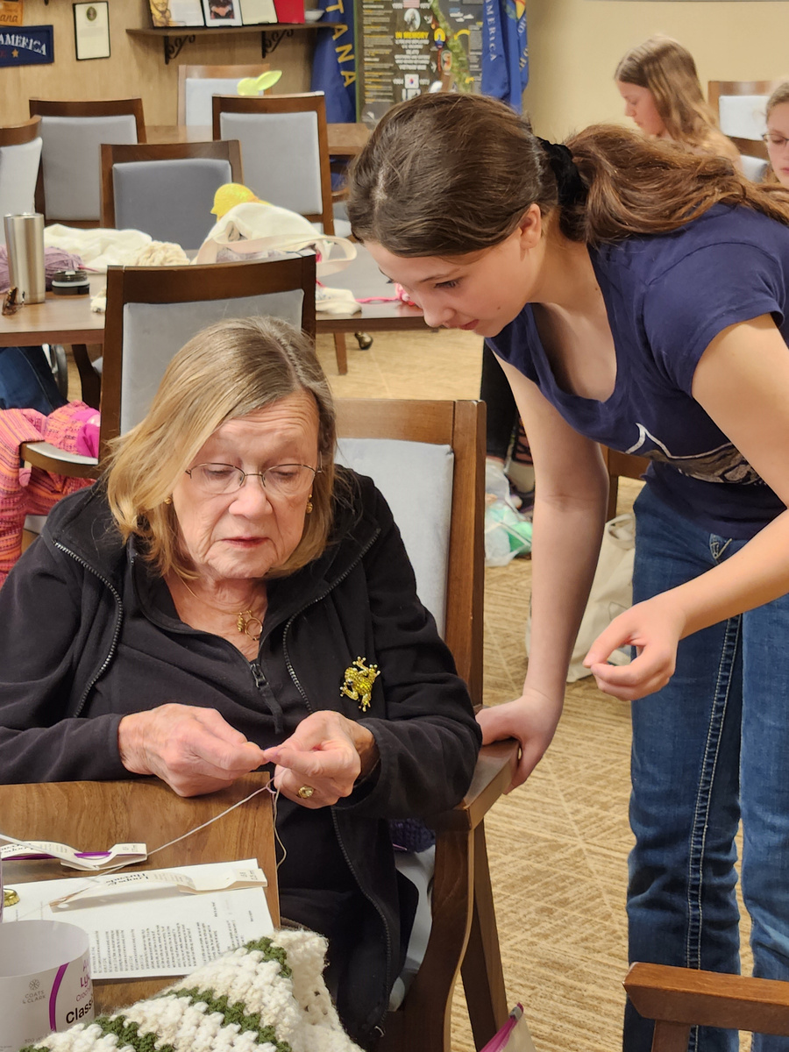
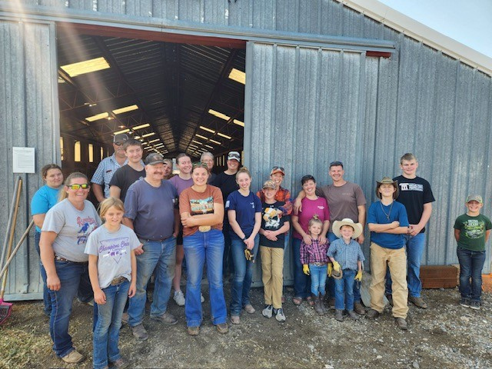
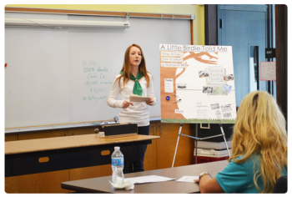
4X
42%
5X
are more aware of important needs in their community after joining 4-H
more likely to contribute to their communities.
more likely to graduate college.
66%
70%
reported they are more willing to speak in front of groups after joining 4-H
indicated knowing how to prepare a presentation after participating in 4-H
2X
more likely to make healthier choices.

Slide 9
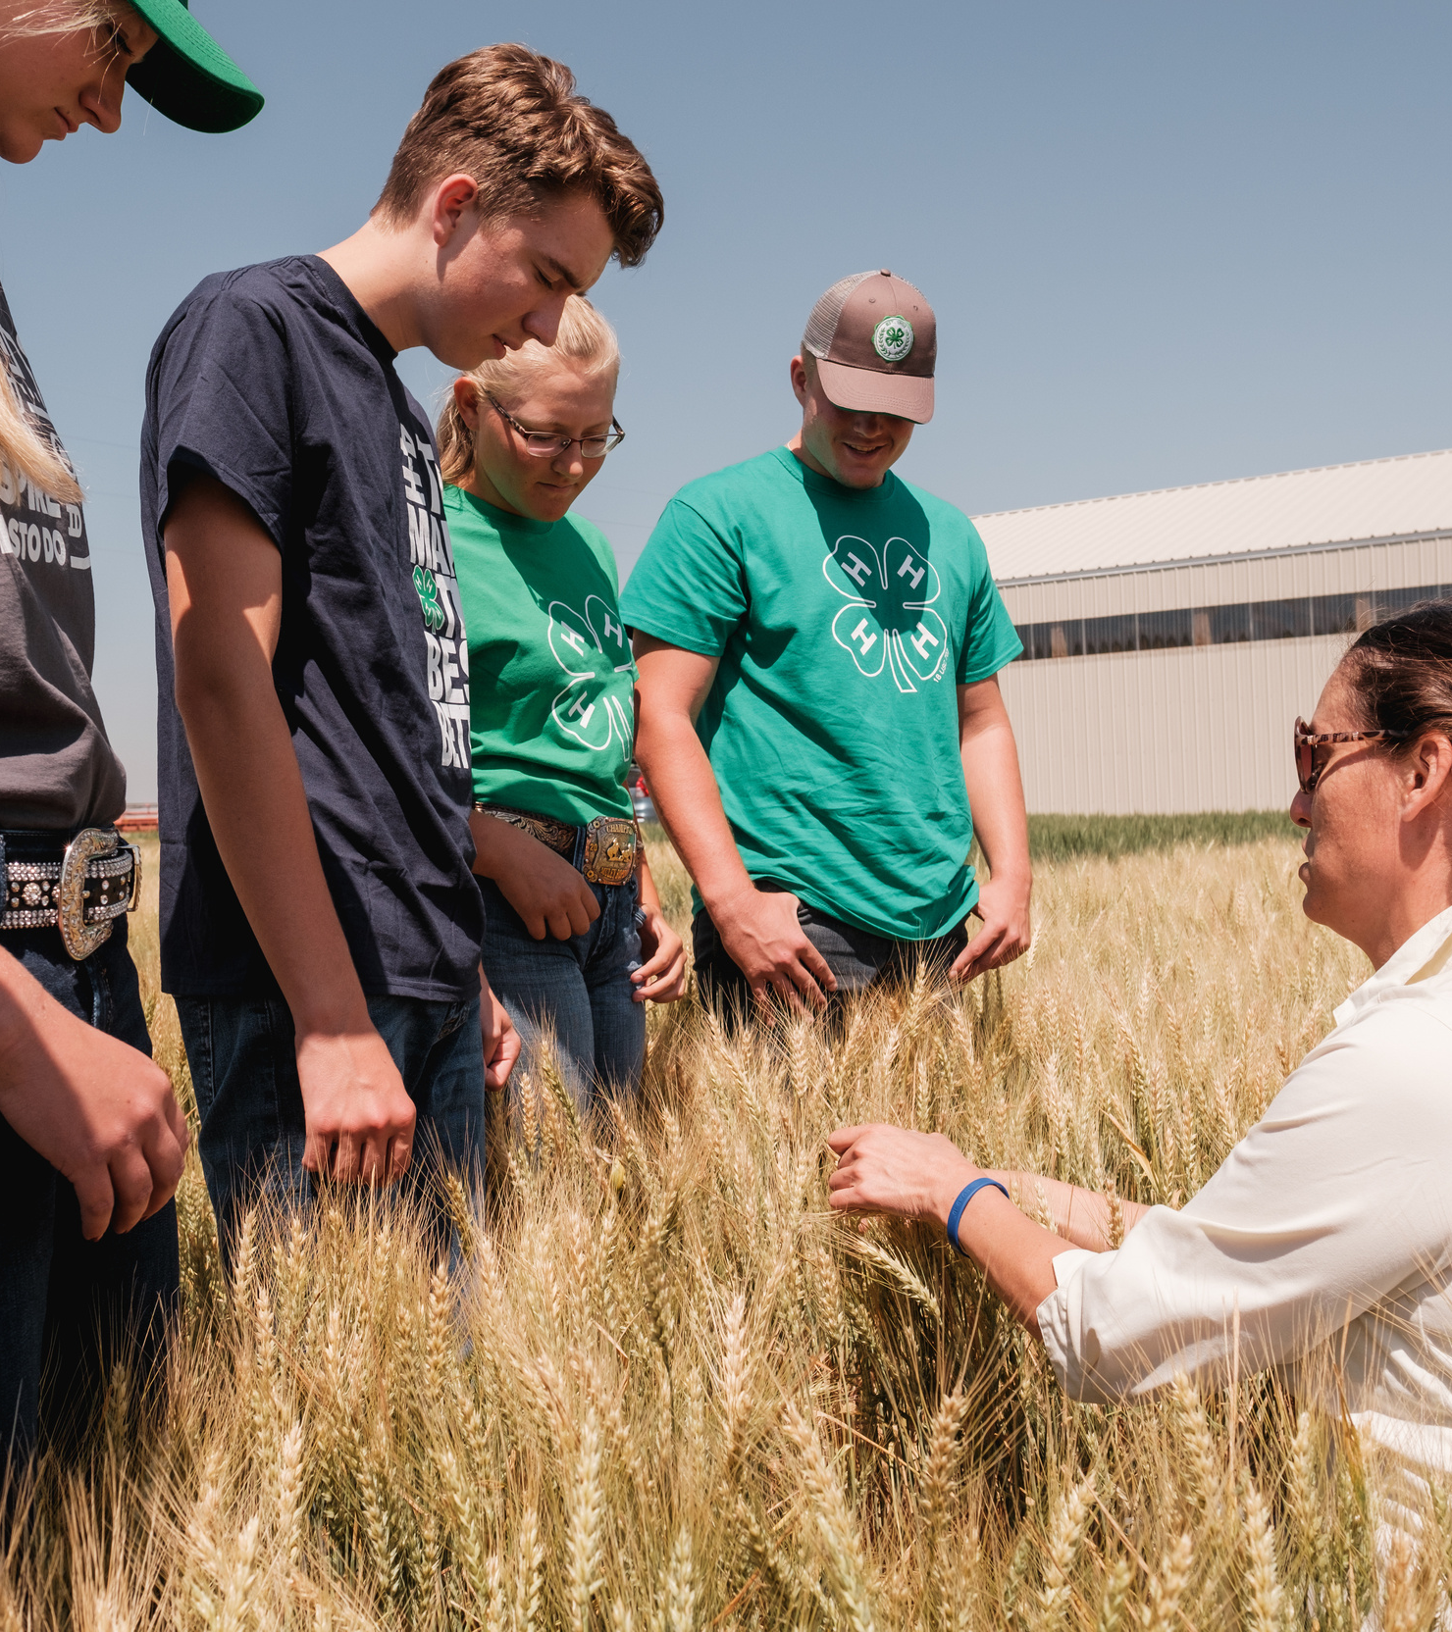
Certified Volunteers
  4-H is made possible through adult volunteers
  What is required to be a volunteer?
    Application
    Background check
    Training
  Chance to be a caring adult that has a positive impact on the future of youth.
  Volunteer in an area that you feel comfortable and have time for.
  Attend trainings and conferences with other 4-H volunteers to share ideas, learn and make friends around the state.

Slide 10
Enrolling In 4-H
GALLATIN COUNTY

Slide 11

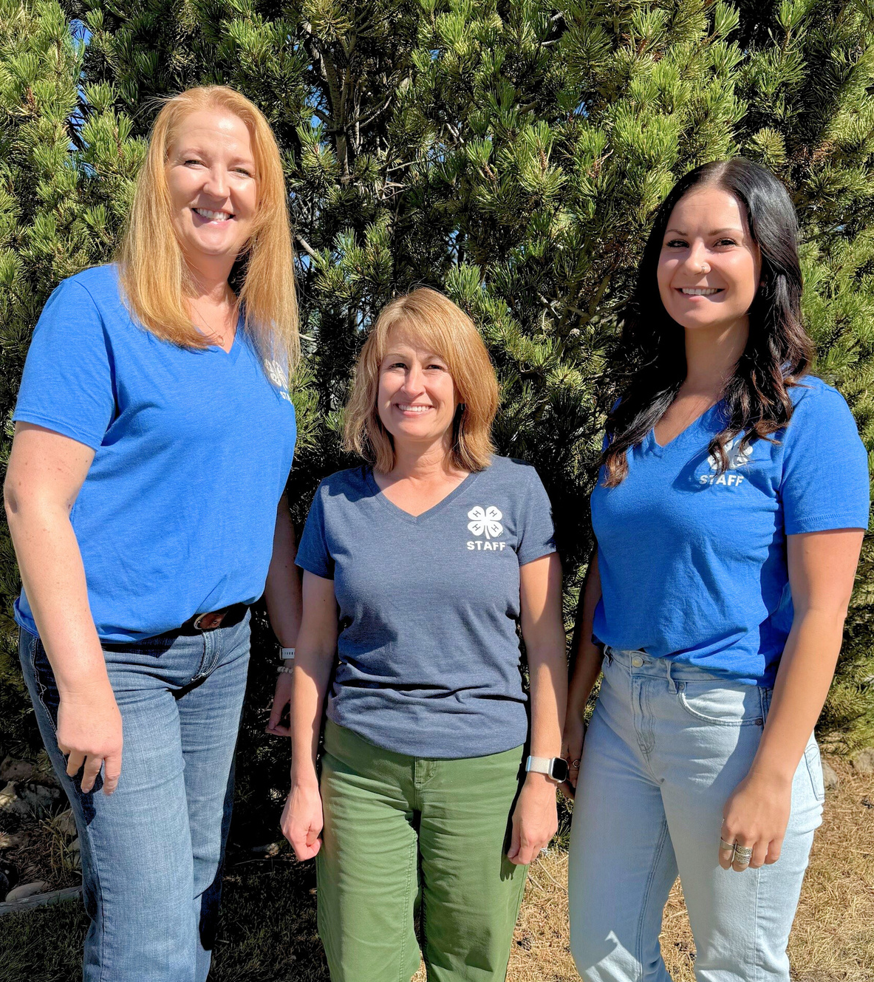

Gallatin County 4-H Office Staff
Molly Yurdana: 4-H Extension Agent (molly.yurdana@montana.edu)
  Oversees the county 4-H Program - bridge between MSU, State 4-H and County. Facilitates trainings and coordinates events
  “Human Manager”
Colyn Wiening: 4-H Program Assistant (gallatin4h@montana.edu)
  Provides support to the 4-H programs and families and handles all 4-H finances.
  Answers questions on enrollment, club/projects, upcoming trainings and fundraisers.
Kari Ballenger: Administrative Assistant (gallatin@montana.edu)
  At the front desk in our office and provides assistance to all Gallatin County MSU Extension events and programs.

Slide 12

Who Can Join 4-H?
CLOVERBUDS
  Youth ages 5-7 as of Oct. 1st of the 4-H Year
  Limited participation (Cloverbuds, Cat, Rabbit, Poultry, Horseless Horse ONLY)
  Introduction to 4-H skills and projects
YOUTH MEMBERS
GALLATIN COUNTY
  Youth ages 8-18 as of Oct. 1st of the 4-H Year
  Must be 9 for most Shooting Sports, 10 for Shotgun & 12 for Muzzleloading
  19 year olds allowed if still in high school
  650+ youth members each year
  Approx. 140 volunteers each year
VOLUNTEERS
  Certified leaders that make 4-H possible
  19+ in age, 21+ to chaperone

Slide 13
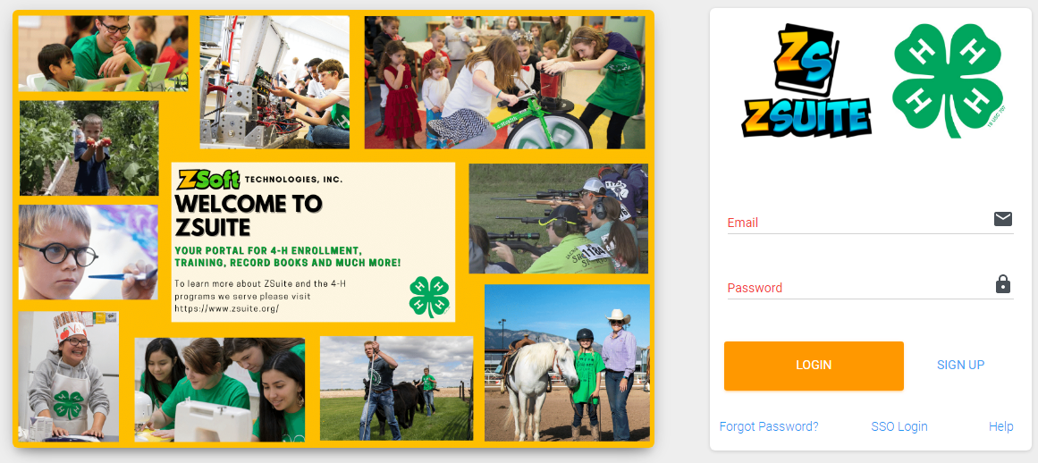
Enrolling in 4-H on ZSuite

Slide 14
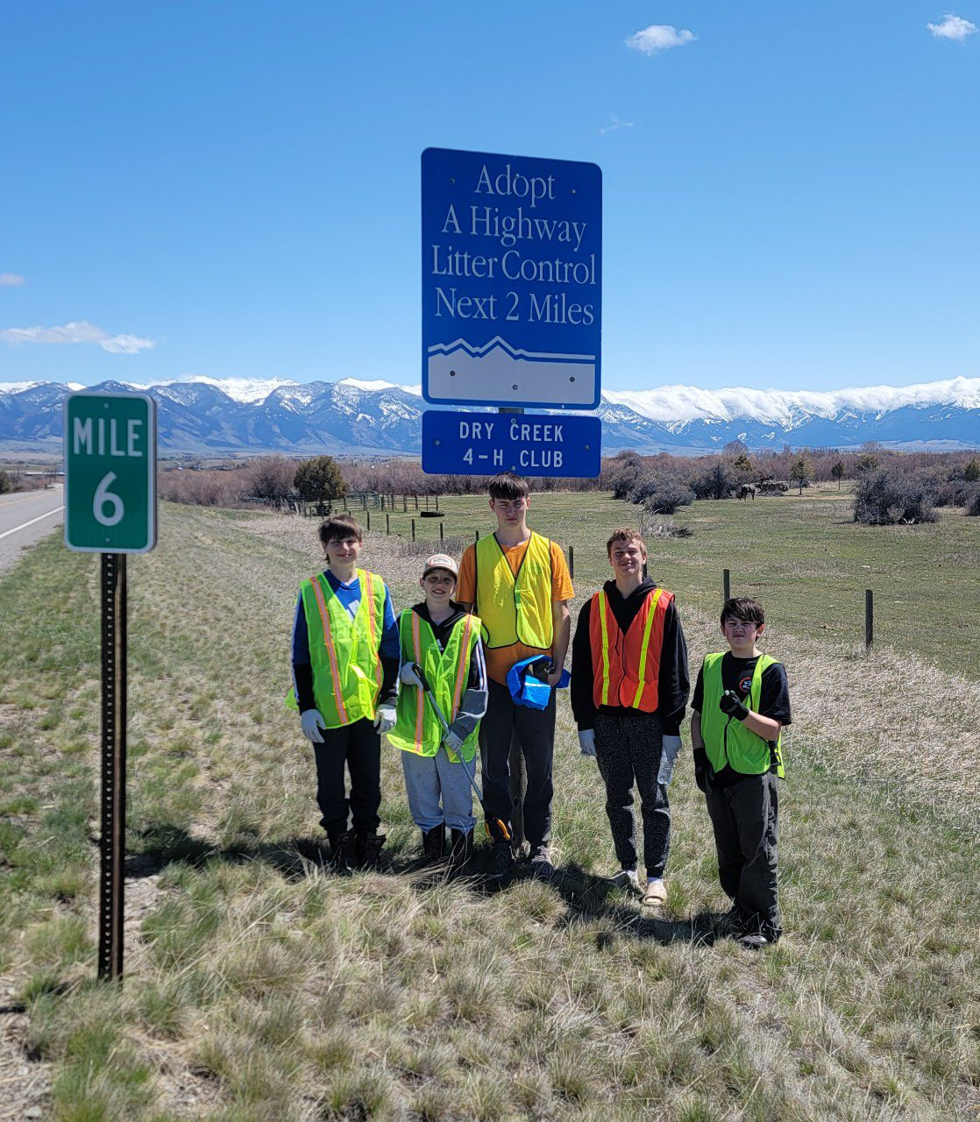
4-H Clubs
  Not a requirement, but highly encouraged
  4-H clubs are a great resource
  Why is it important to join a 4-H club?
    Belonging and Generosity
    Leadership opportunities, community service, officers, diversity and fun!
  How do you pick the right club for your family?
    Location, Meeting Time, Age of Club
  Members At Large
2026-2027 Club List

Slide 15
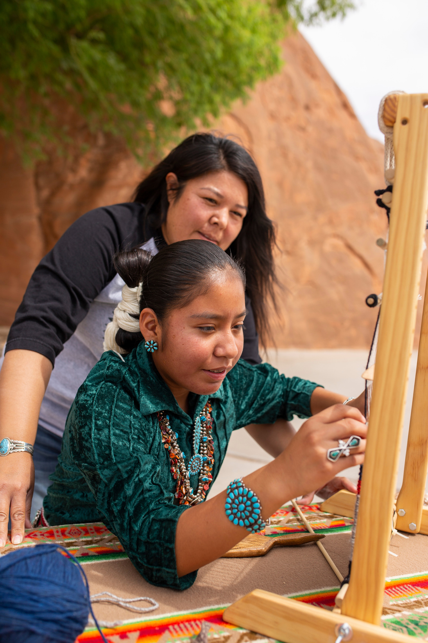
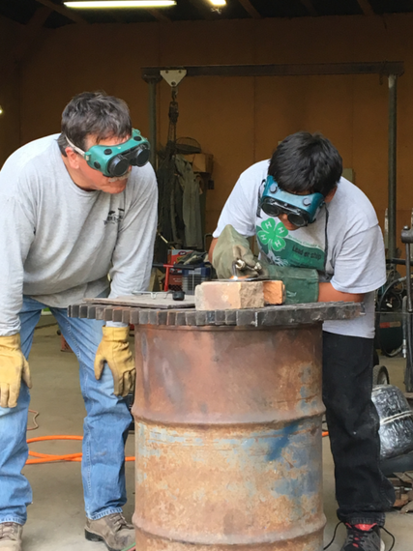
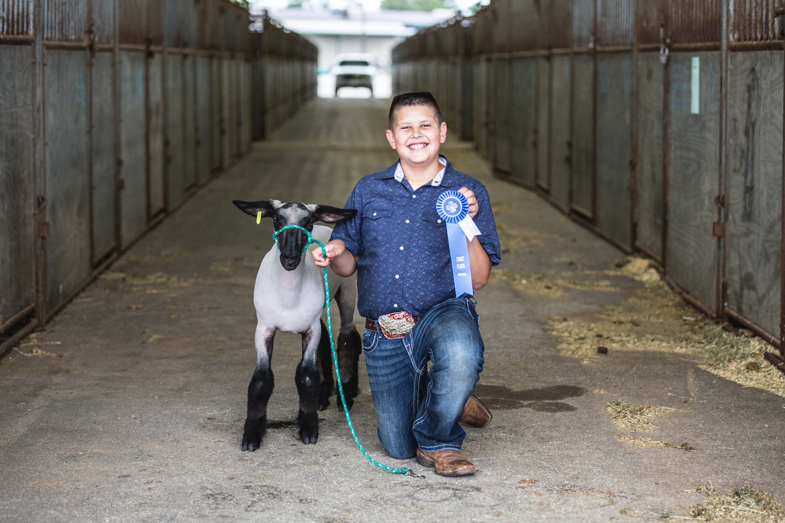
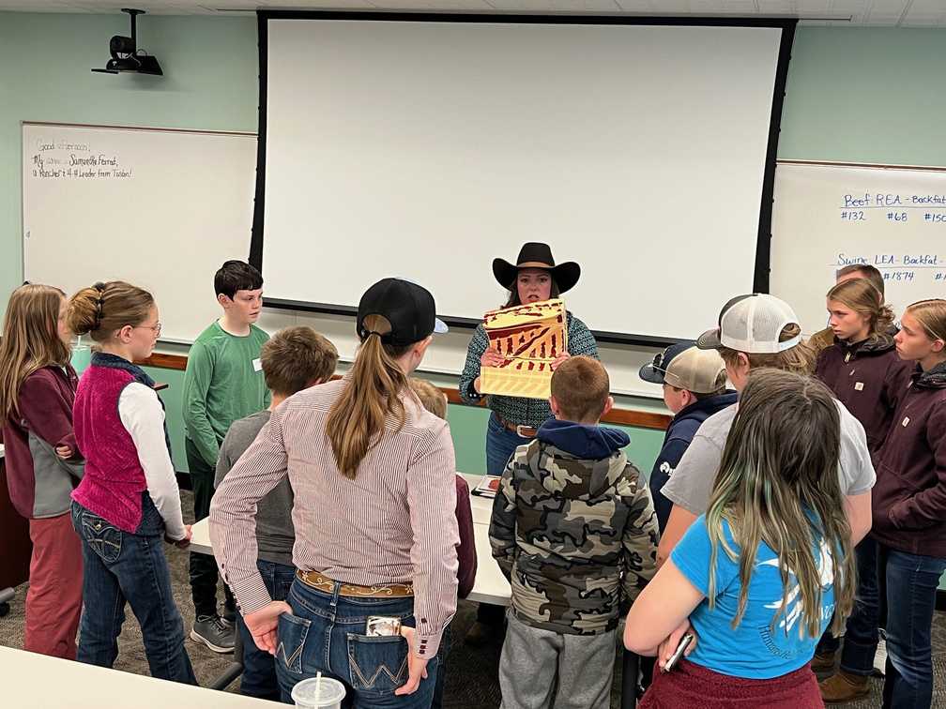
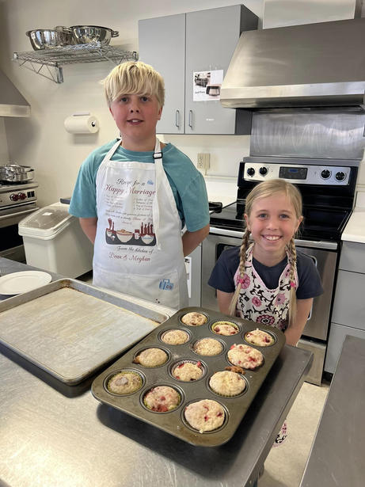
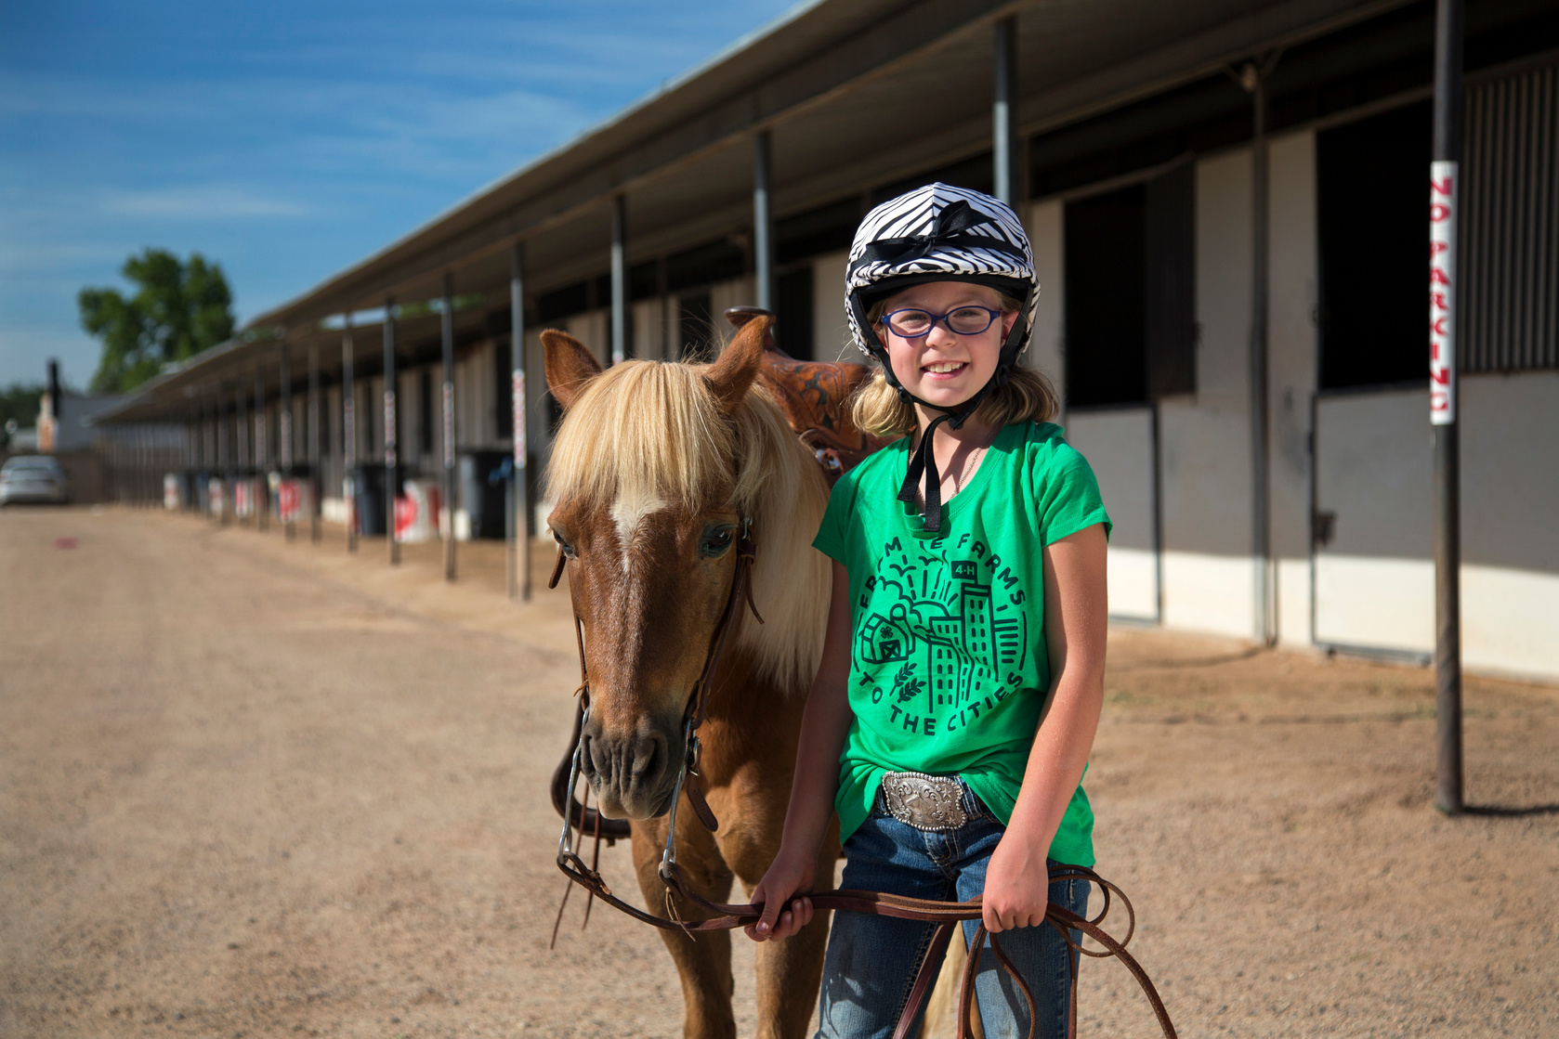
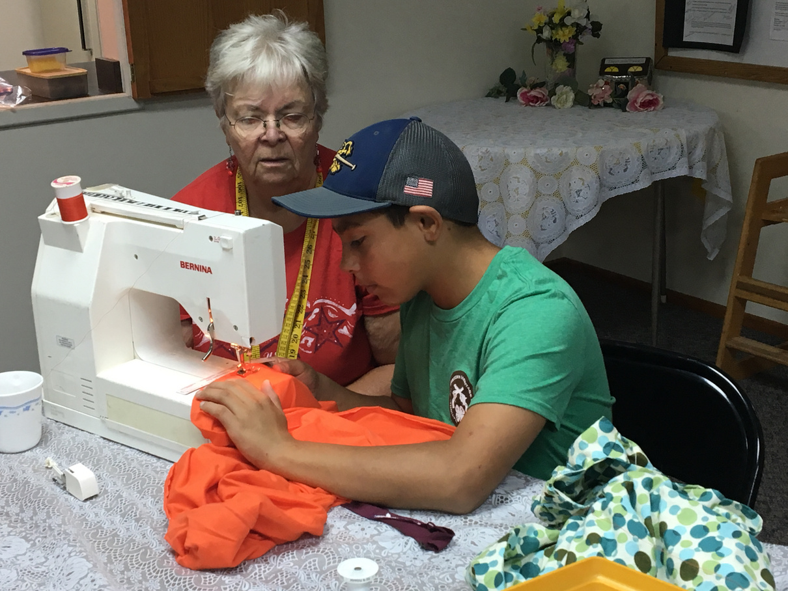
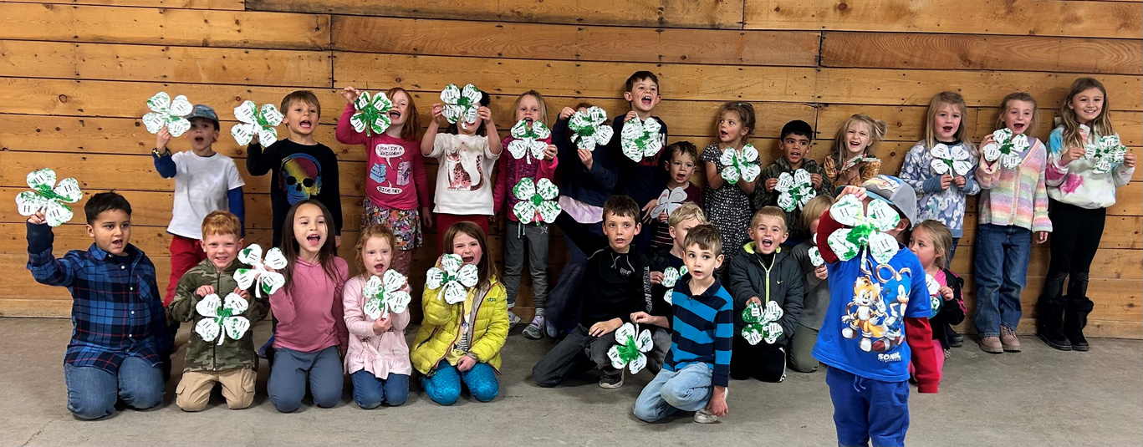
4-H Projects
  Pick based on what skill/topic your child is interested in learning about
  Projects are real life experiences that help 4-H’ers learn
  Projects focus on hands-on learning
  Many of the projects offer different levels to encourage youth to challenge themselves
  Curriculum is research based
  Project meetings and workshops (1 meeting per month per project on average)
2026-2027 Indoor Projects
2026-2027 Animal Projects

Slide 16
What does 4-H Cost?
Gallatin County 4-H Annual Enrollment Fees (2025-2026)
Other costs:
  Fair Registration Fees ($5-20/animal)
  Purchasing supplies for your project(s)
  Attending other 4-H events around the state/county
  Youth Members (ages 5-19) = $30 per child
  Volunteers = $10
  Project Fee = $5 per project
  Additional Fees
    Shooting Sports = $40 (per discipline)
    Cooking = $25
    Baking = $25
    Cake Decorating = $25
    Robotics = $25

Slide 17
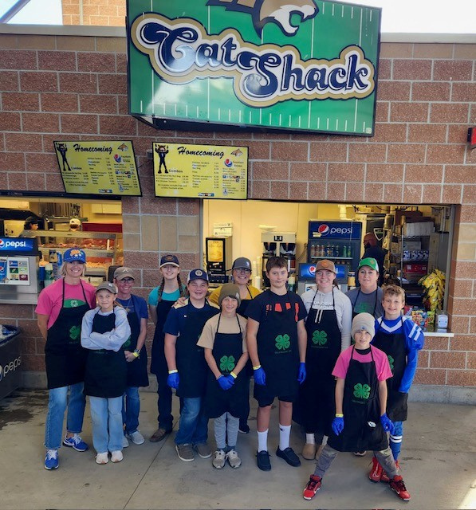
Fundraising & Community Service
Fundraising and financial management are some of the life skills 4-H strives to teach youth. By participating in fundraisers, you are directly contributing to the growth and success of 4-H, ensuring that we can continue to provide valuable opportunities for youth development and community engagement.
  Program Support
  Youth Development Opportunities
  Community Engagement
  Enhanced Experiences
  Volunteer Support
  Recognition and Celebration
  Sustainability
Community Service helps 4-H members:
  Build Character and Compassion
  Connect with Their Community
  Strengthen Skills for the Future

Slide 18
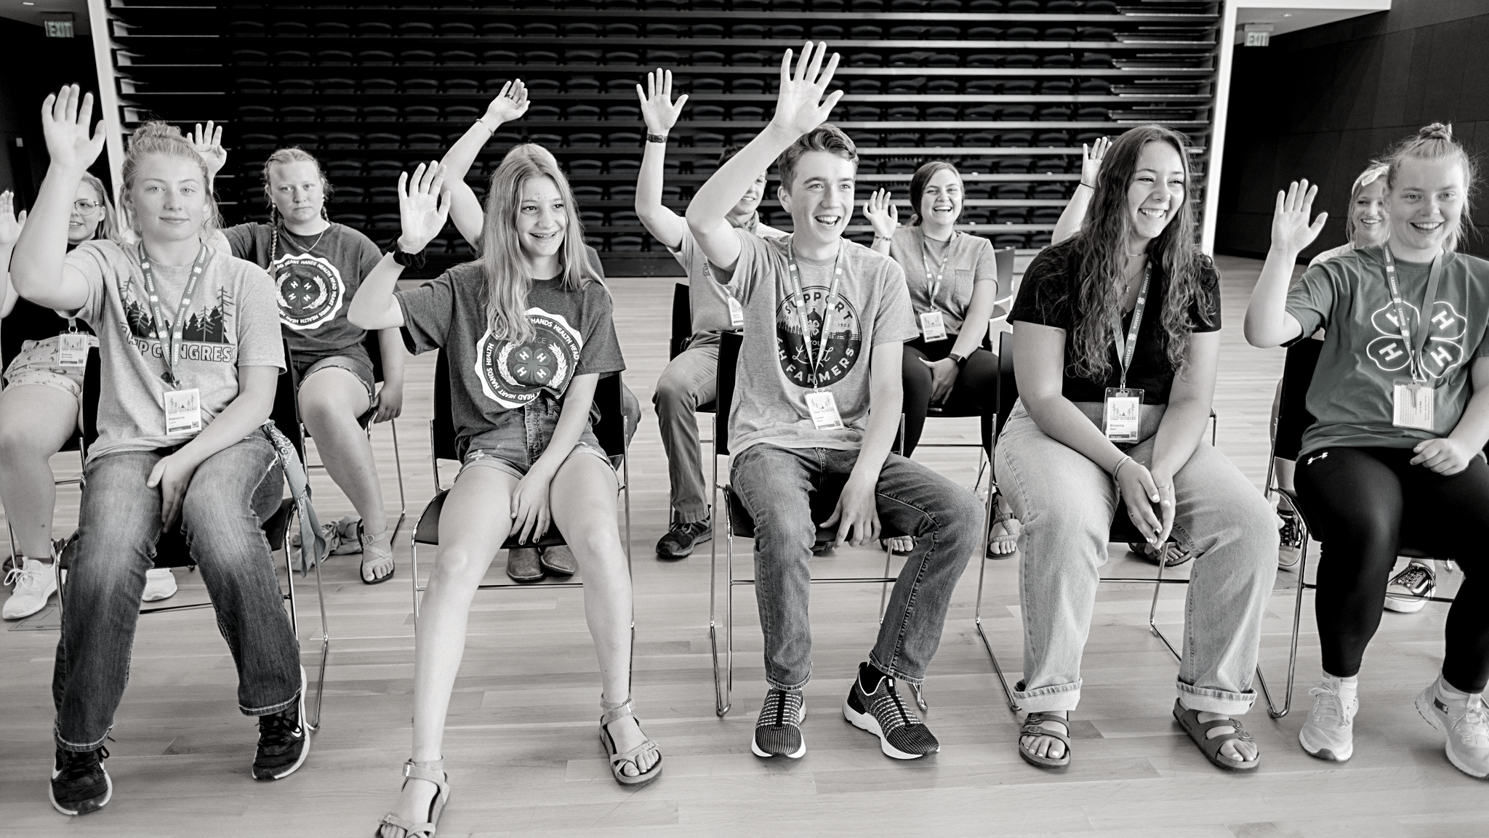
Other Opportunities in 4-H

Slide 19
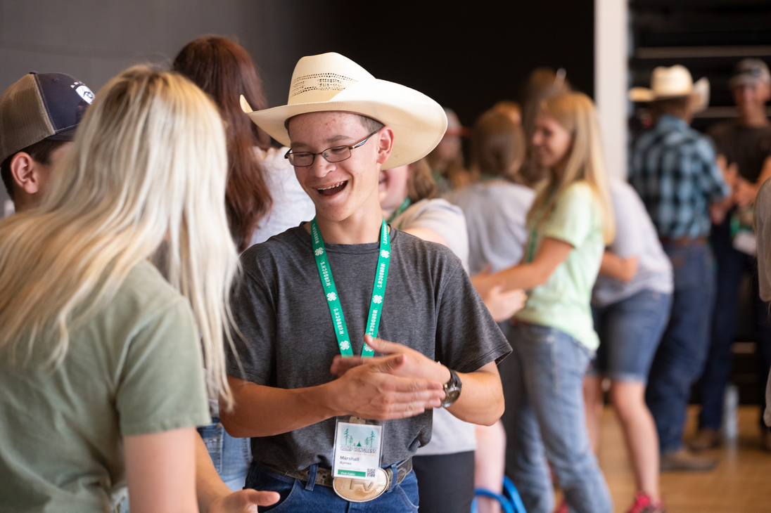
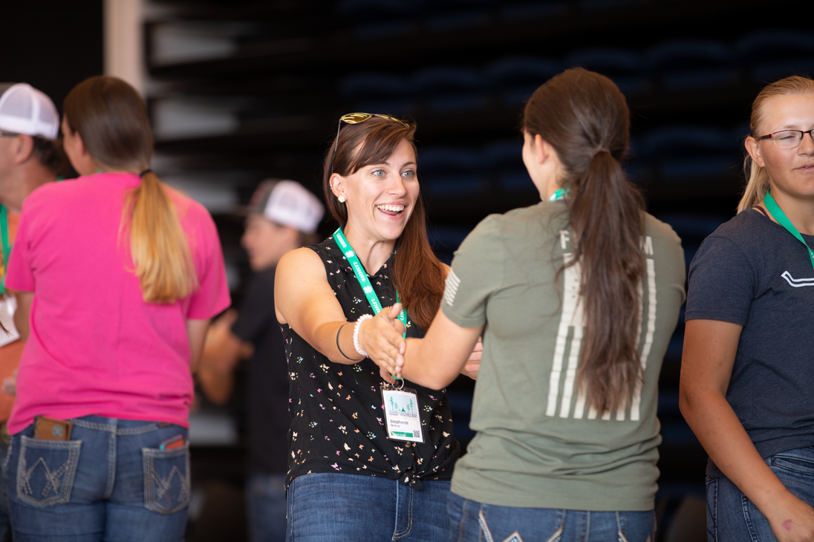
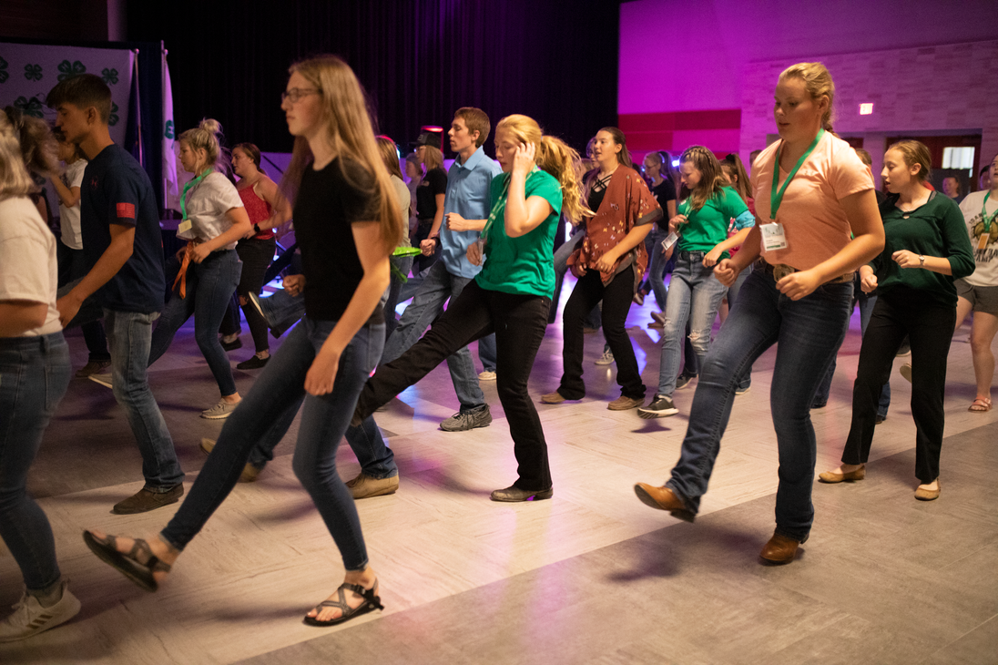
The Opportunities are ENDLESS!
County Events
County Activities
  Communication Day
  Stir-Ups
  Better Batter Baking
  Big Sky Country State Fair
  4-H Summer Camp
  Bozeman Stampede
  Potato Festival
  Awards Night
  Promotional Booths
  MSU Concession Fundraising
  Workshops
  Animal Quality Assurance
  4-H Cafe
  National 4-H Week
State Events
  Fall Leadership Training
  Leadership Academy
  Rec Lab
  State Shoot
  State Horse Shows
  Pre-Congress
  State Congress

Slide 20


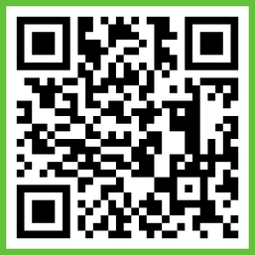


Where to Find 4-H Information
Gallatin County 4-H Website
  Forms and Documents, Calendar, Newsletter, Online enrollment, Record Books
Email Listserv
  Enrolling on ZSuite auto-adds you to our listserv
  Reminders, announcements, newsletter, opportunities, deadlines
Monthly Newsletter
  Monthly 4-H Newsletter with all the information you will need to stay in the loop with 4-H activities, events and opportunities.
BAND App
Facebook

Slide 21
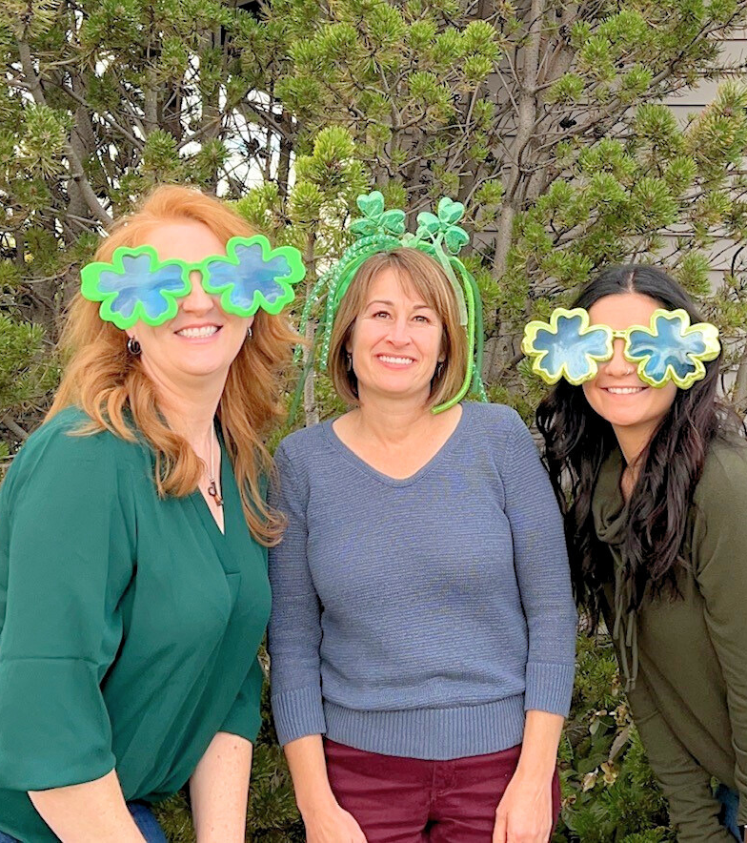
Questions?
Thank you!
We are excited to welcome you to
Gallatin County 4-H!

