Slide 1
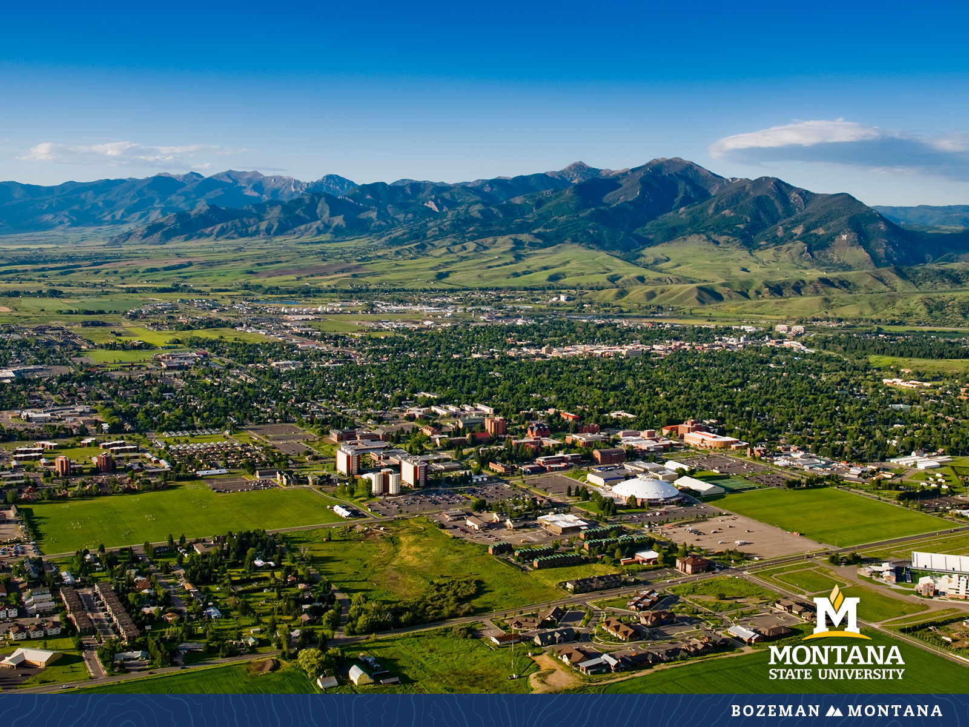
Faculty Senate Meeting November 30, 2022

Slide 2
Gentle Reminders
Faculty Senate is an open and public meeting
Please, only Senators speak in the meeting, unless you are specifically called on by the Chair or Chair-elect to speak
Public may address the Senate at end of the meeting during public comment

Slide 3
Agenda
Approval of Minutes
Information Updates
New Business
Courses and Programs
Senator’s Open Discussion
  Public Comment
  Executive Session
Adjourn

Slide 4
Approval FS Minutes 11/09/22
Do I have a motion to approve?
Any Discussion?
All those in favor of the motion or
Those not in favor of the motion indicate by saying…

Slide 5
FYI Items
  MSU’s first-ever Research Development Day – Jan 12, 2023
In addition to a keynote from the Head of NSF’s Office of Integrative Activities Dr. Alicia Knoedler, the event will feature informational sessions and one-on-one consultations with federal program officers (advance sign-up required).
https://www.montana.edu/calendar/events/43447

Slide 6
FYI Items
  Alumni Foundation Awards for Excellence Update – Return to the existing number of awards, the inclusion of Gallatin College and graduate students, rebranded and linked to Founders Day.
https://www.montana.edu/calendar/events/44079
Today is the last day to submit nominations.

Slide 7
FYI Items
  BOR Meeting Update
    Academic Warning/Academic Suspension Policy change approved to start going into effect in Spring 2023
    Dependent Tuition Waiver Changes Approved
  Fall 2023 Convocation announced. Speaker: Author Stephanie Land. 7 p.m. Tuesday, Aug. 22, 2023

Slide 8
FYI Items
  You are all invited to attend the 2023 MSU Library Open House on Tuesday, January 17, 2023. This year the event will be held in-person from 3-6 p.m. on the 2nd floor of the Library. For the 2023 Open House, the Library will broadly celebrate a theme of "Opening Possibilities." The Library is looking forward to gathering with MSU faculty, staff, graduate students, and Bozeman community members to enjoy food and beverages, listen to music, and explore the services offered by MSU Library and its partners. For more information, please visit this page: https://www.lib.montana.edu/about/news-and-events/annualevents/open_house/2023_open_house.html.

Slide 9
FYI Items
    Student Art Wall competition: The Norm Asbjornson Hall first-floor artwork panel (approximately 20 feet wide x 10 feet high) is adjacent to the main passenger elevator on the south side of the central atrium. The winning student or team will receive a $2,500 scholarship and funding for the materials and installation.
    Proposals must be submitted electronically by Friday, January 20, 2023.

Slide 10
  New Business:
  Changes to Graduate Policy
  Dr. Craig Ogilve- Graduate Dean

Slide 11
  Graduate Policy Workflow
Graduate Student Policies identified by JAGS as having direct impacts on faculty will receive two readings in Faculty Senate.
Allow for discussion and questions to the Dean of the Graduate School.
Upon two readings, the faculty senate will entertain a motion to approve.
The policy will also be considered in Academic Council.
The policy will then move forward to the Provost and President for approval before updating the graduate handbook.

Slide 12
Age of Courses Policy Revision- Full text on FS Webpage
This proposal changes the time periods for different degrees.
  Reduces the masters age-of-courses from six to five years and doctoral from ten to seven years.
  New is that online programs have an additional two years to acknowledge that many people enrolled in these courses are also working professionals.
The goal is to encourage continuously enrolled students to complete their degrees in a timely manner.
The change would not take effect until Fall 2024 to provide time for current students to finish.

Slide 13
Time Related Policies Revision- full text on faculty senate webpage
We currently have a policy that the comprehensive exam is valid for five years for doctoral students. https://www.montana.edu/gradschool/policy/degreq_doctoral.html#degreq_doc_comp
We do not currently have a policy on when students should take and pass the comprehensive exams, i.e. how soon after the student starts their doctorate
The proposal is to make both timeframes be 4 years.

Slide 14
Review of Research Faculty to serve as graduate committee chairs- full text on faculty senate website
Research faculty are defined in the Faculty Handbook https://www.montana.edu/policy/faculty_handbook/appointment_employment.html#research
The faculty handbook also describes how research faculty can serve as sole chairs of graduate committees.
  “In addition to their research responsibilities, research faculty may have educational and service responsibilities, provided these activities comply with the regulations and restrictions of the agency funding their appointment and are consistent with Graduate School policies. These activities include, but are not limited to, supervising graduate students, chairing of graduate committees, serving on graduate student committees, teaching seminars and courses, and serving on departmental or college curriculum committees.”

Slide 15
Review of Research Faculty to serve as graduate committee chairs- full text on faculty senate website
The proposed policy aligns the graduate school’s handbook with the faculty handbook.
The goals are to
  Provide graduate students the opportunity to be advised by some of MSU’s top research faculty.
  Provide a career development path for these members of the MSU scholarly community.

Slide 16
Review of Research Faculty to serve as graduate committee chairs- full text on faculty senate website
The key steps are:
A research faculty member submits a request to the academic unit head
The research faculty member submits information to the academic unit head that the academic unit needs to make a decision; this could include a CV and a statement of interest.
A review of the nominee by the tenure track faculty in the academic unit and an affirmative vote by these faculty.
After an affirming vote, the academic unit head sends a letter of support to the Graduate School for the nominee, including how the candidate’s expertise will benefit graduate students in the academic unit and how student advising responsibilities fit within the candidate’s duties. Workload and compensation issues are to be decided between the research faculty and the academic unit.

Slide 17
Undergraduate Courses- First Reading:
    EENV 202 : Sustainable Waste Management
    HEE 340 : Methods of Health Education
    HVC 260 : Commercial Air Conditioning and Refrigeration

Slide 18
Undergraduate Courses- Second Reading:
    SOCI 375 : Law & Globalization
    EENV 498 : Internship
    HSTR 426 : History of Yoga: East and West
    ITS 125 : Fundamentals of Voice and Data Cabling
    ITS 250 : CCNA 3: Exploration
    ITS 252 : CCNA 4: Exploration
    MCH 242 : CNC Probing and Macros
    M 362 : Linear Optimization^{*was reviewed and approved}

Slide 19
Undergraduate Course Changes- First Reading:
    EBME 100 : Introduction to Biomedical Engineering
      Credit change from 1 to 2
      Additional learning outcomes
      Combining EBME 100 and EBME 102 outcomes. Will become one course.

Slide 20
Undergraduate Course Changes- Second Reading:
    ECHM 201 : Material and Energy Balances for Chemical & Biological Processes
      Title change from Elementary Principles of Chemical and Biological Engineering
    PSCI 347 :The U.S. Congress and the Legislative Process
      Title change from Legislative Process
      Number change from 306 to 347, per OCHE/CCN.

Slide 21
Undergraduate Course Inactivations- First Reading:
    BIOB 377 : Practical Genetics
      Course is no longer being offered as it was determined to be too similar in content to BIOB 375
    HORT 447 : Advanced Plant Propagation
      Instructor who taught this course left MSU. Current programs don't need this course.

Slide 22
Graduate Courses- First Reading:
    BIOO 537 : Plant Development
    CSCI 545 : Advanced Human Computer Interaction HDCO 542 : Communication and Helping Skills
    NRSG 639 : Midwifery Clinical Care Skills and Procedures
    NRSG 640 : Advanced Pharmacology II Nurse Midwifery
    NRSG 641 : Midwifery Care During the Antepartum
    NRSG 642 : Midwifery Care During the Intrapartum
    NRSG 643 : Midwifery Care During the Postpartum and Care of the Neonate

Slide 23
Graduate Courses- First Reading:
      NRSG 644 : Primary and Gynecologic Care
      NRSG 645 : Advanced Midwifery Clinical I
      NRSG 646 : Advanced Midwifery Clinical II
      NRSG 647 : Advanced Midwifery Clinical III
      NRSG 648 : Advanced Midwifery Clinical IV
      PSPP 501 : Navigating Graduate Studies
      STAT 500 : Applied Methods in Statistics

Slide 24
Graduate Courses- First Reading:
      NRSG 644 : Primary and Gynecologic Care
      NRSG 645 : Advanced Midwifery Clinical I
      NRSG 646 : Advanced Midwifery Clinical II
      NRSG 647 : Advanced Midwifery Clinical III
      NRSG 648 : Advanced Midwifery Clinical IV
      PSPP 501 : Navigating Graduate Studies
      STAT 500 : Applied Methods in Statistics

Slide 25
Graduate Course Changes-First Reading:
    NRSG 575 : Professional Paper and Project
        Credit change from 1-4 to 2
    NRSG 604 : Evidence Based Practice I
        Credit change from 4 to 3
    PHSX 575: Conceptual Physics for Teachers
        Number change from 497
        Some students are running into trouble with the 400 level course offering. Because they are graduate students, school districts and administrators are looking for 500 level courses. Plus, there is a limit on how many 400 level courses can be on a graduate Program of Study. This course is of appropriate breadth and depth to be considered a 500-level course.

Slide 26
Graduate Course Changes-First Reading:
    PSCI 551 : Quantitative Research Methods
        Title change from Research Methods for Public Administrators
    SFBS 552 : State of the Food Environment
        Title change from State of the Environment: Policy, Management, and Practice

Slide 27
Graduate Course Changes-Second Reading:
HDCO 550 : Counseling Research and Evaluation
  Credit change from 2 to 3
MSSE 503 : Integrating Literature into the Biology/Life Science Classroom
  Title changed fromMSSE 503 : Integrating Literature into the Science Classroom

Slide 28
Graduate Course Inactivations-First Reading:
ECNS 575 : Professional Paper and Project
  This graduate program option is no longer available. Thus, the professional paper course is obsolete. This option was only used by 1 student since its inception over 30 years ago.

Slide 29
Graduate Course Inactivations-Second Reading:
    M 571 : Principles of Action Research in Mathematics Education
      Course has not been offered in over a decade. Students instead take M 577.
    M 572 : Investigating Problems in Mathematics Education
      Course has not been offered in over a decade. Students now take M 577 instead.

Slide 30
Graduate Programs-First Reading:
CTCO-CERT : Chemistry Teaching
ELTO-CERT : Elementary Science Teaching
ESTO-CERT : Earth Science Teaching
LSTO-CERT : Life Science Teaching
PTCO-CER : Physics Teaching

Slide 31
Graduate Programs-Second Reading:
DNMW-DNP : Doctor of Nursing Practice - Nurse Midwife

Slide 32
Graduate Program Changes-Second Reading:
SCNS-MED : School Counseling

Slide 33
Old Business
Faculty Senate Leadership for Spring 2023

Slide 34
Senate Open Discussion

Slide 35
Public Comment

Slide 36
Next Meeting November 30, 2022

Slide 37
Faculty Senate Meeting Adjourned

