Slide 1


Traveling the winding road to Adulthood…
Dr. Matthew R. Caires, dean of students
mcaires@montana.edu

Slide 2

The Parents’ Guide to a Successful Freshman Year
1. A historical perspective
2. From Rights to Responsibilities…
3. Campus rules and resources
4. Advice from the Dean of Students
Notes:
Remove?

Slide 3
The Evolution of Higher Education in America
What and when was the first college founded in N. America?
Harvard College, 1636
What did it generally look like?
Generally colleges were small, residential, religious affiliated, and all men
Teaching vs. Research
What were the “student life” issues during this time?
Attending class
Adhering to community standards
Alcohol
What did campus discipline look like?
Flogging
Boxing
Notes:
Remove?

Slide 4
Higher Education’s Legal Relationship with College Students
In Loco Parentis
- “In the place of the parent”
Sir William Blackstone - 1765
“A father may also delegate part of his parental authority during his life to the tutor or schoolmaster of his child; who is then in loco parentis, and has such a portion of the power of the parent committed to his charge, viz. that of restraint and correction, as may be necessary to answer the purposes for which he is employed”
Notes:
Remove?

Slide 5
Higher Education’s Legal Relationship with College Students
Did students have “rights?”
Gott v. Berea College, 161 SW. 204 (Ky. 1913)
“Colleges stand in loco parentis concerning the physical and moral welfare and mental training of the pupils, and … to that end [may make] any rule or regulation for the government or betterment of their pupils that a parent could for the same purpose unless unlawful or contrary to public policy.”
Notes:
Remove?

Slide 6
The Fall and Fallout of In Loco Parentis (1900s - 1960s)
Changing demographics and role for colleges and universities
Research mission and the role of Faculty
Co-Education
Deans of Women and Deans of Men
Intercollegiate Athletics, Depression, WWII, GI Bill, returning veterans, fraternities
Older students and desires for new freedoms (visitation, expression, etc)
Notes:
Remove?

Slide 7
The Fall and Fallout of In Loco Parentis (1900s - 1960s)
Dixon v. Alabama State Board of Education, (5th Cir. 1961)
“In this case, six black students at Alabama State College (ASC) were notified in a letter from the college President that they were expelled for participating in civil rights demonstrations that sought to desegregate a variety of public services. They were not told what specific misconduct they were charged with or for what reason they were expelled.”
Notes:
Remove?

Slide 8
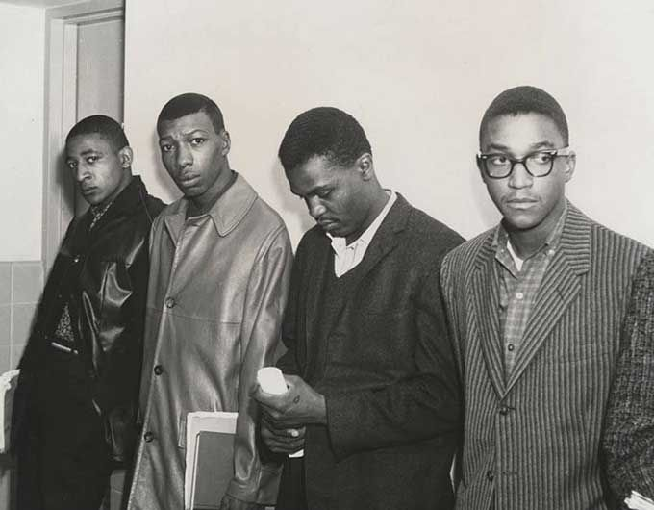
The Fall and Fallout of In Loco Parentis (1900s - 1960s)
Dixon v. Alabama State Board of Education, (5th Cir. 1961)
Notes:
Remove?

Slide 9
Students as adults (1960s – 1980s)
FERPA - 1974
Voting at 18 years old
Drinking age? - Depended on the state
Vietnam and Civil Rights
Disengagement of college deans and faculty from traditional “student life” issues
Notes:
Remove?

Slide 10
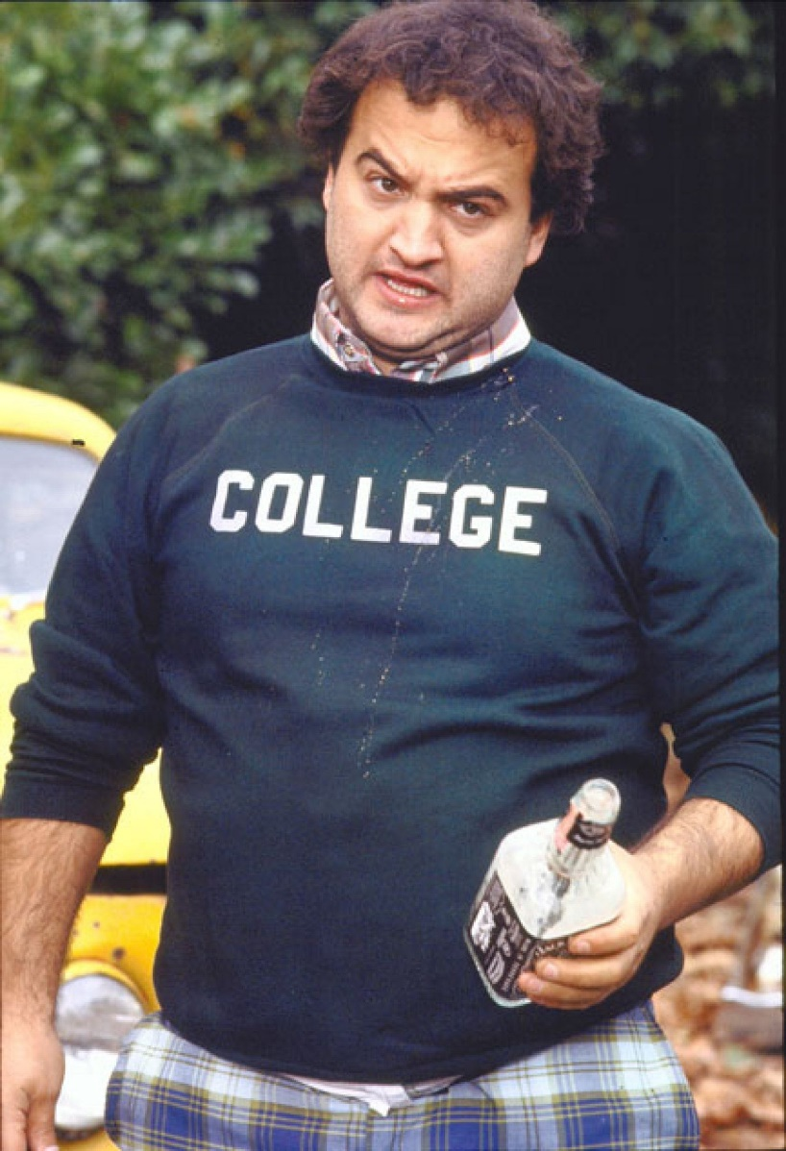
But with more freedom…..
Animal House
Notes:
Remove?

Slide 11
But with more freedom…..
Animal House
Binge drinking and the rights of passage
Student injuries
Drugs, counter-culture, sexual revolution, “The Man”, and then Kent State.
Campus life was in “chaos”
Legal relationship with students - Bystander
Notes:
Remove?

Slide 12
Students as adults (1980s and beyond)
The pendulum starts to swing back
From rights to more responsibility…
Drinking age? - 21 years old
FERPA revisited
A new In Loco Parentis?
Legal relationship with students - Facilitators
Notes:
Remove?

Slide 13
Where does this leave US today?

Slide 14
Parents as Partners

Slide 15
Who are our students today?
Are they adults?
Are they still children?
How do we know???
Jeffrey Arnett “Emerging Adulthood”
“Generation Z” Goes to College
Notes:
Remove?

Slide 16
Services and Resources
Office of the Dean of Students
Strand Union Building 174
Student support in times of “crisis.”
Parent and Family Relations
Fraternity and Sorority Life
Student Conduct & Safety
Student conflict resolution
Notes:
Remove?

Slide 17
Student Code of Conduct
Educational process
Alcohol and drug policy
Sexual misconduct, violence, weapons or hostile acts towards others
Campus Civil Rights
University Police Department
Clery Act – Crime Statistics
Notes:
Remove?

Slide 18
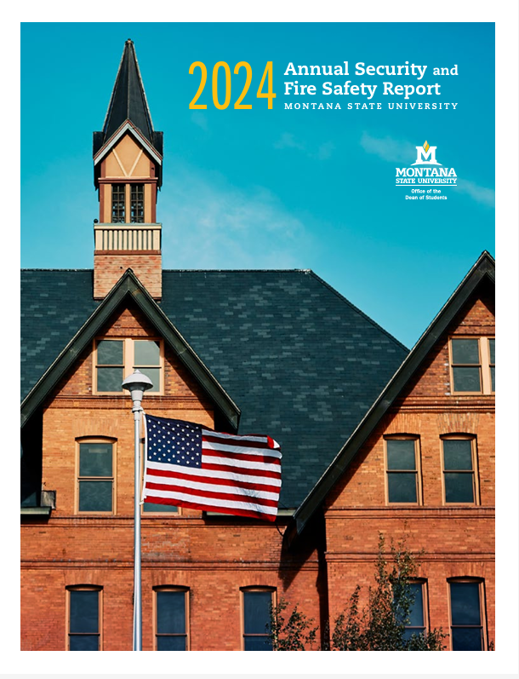
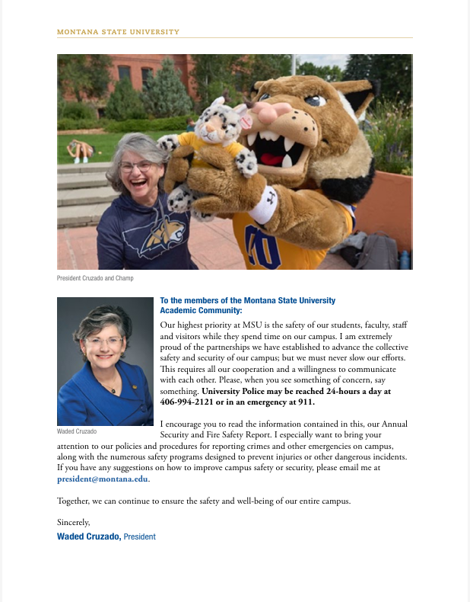
Annual Security Report
Notes:
Remove?

Slide 19
Tips for Parents
Move-In Weekend
Go away!
Attend Parent & Family Weekend - October 23-25
Ask open ended and difficult questions
Social life, roommates, classes, alcohol, advisors, asking for help – Parents’ Guide to Difficult Questions
Read our emails!
Eating ramen builds character
A university experience is SUPPOSED to be challenging.

Slide 20
Tips for Parents
Bring a bike to campus
Meet their professors, all their professors, go to their office hours
Go to class, and tell their friends they need to go to class
Encourage campus involvement in a club or a campus organization
Go get a job!

Slide 21
Tips for Parents
ASK US FOR HELP!
Parent and Family Hotline
(406) 994-7359
www.montana.edu/parents
Parents@montana.edu

Slide 22
Office of the Dean of Students
Montana State University
www.montana.edu/deanofstudents
mcaires@montana.edu
(406) 994-2826
Notes:
Remove?

