Slide 1
Finding & Supporting National Security Research Opportunities at MSU
Adjacent Topic: How to Work with the Applied Research Lab
Dr David Miller, NACOE, davidmiller@montana.edu
Ben Dahlke, ARL, benjamin.dahlke@montana.edu

Slide 2
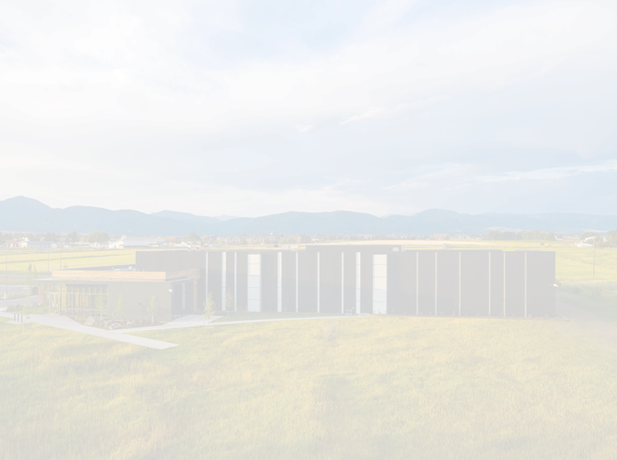
Why National Security Research?
Finding Funding
Traditional / Non-Traditional
MSU Tools
Restricted Research Policy & Terminology
Linking to MSU Expertise
Working with the ARL
What we do
ARL Support for Researchers

Slide 3
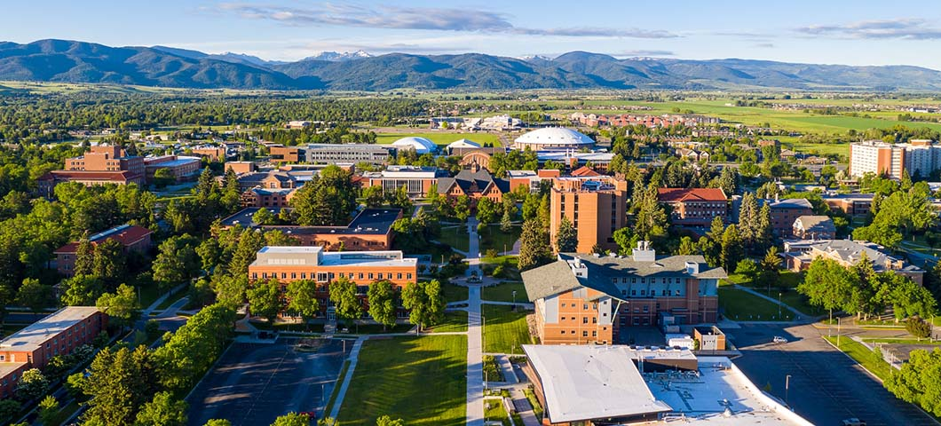
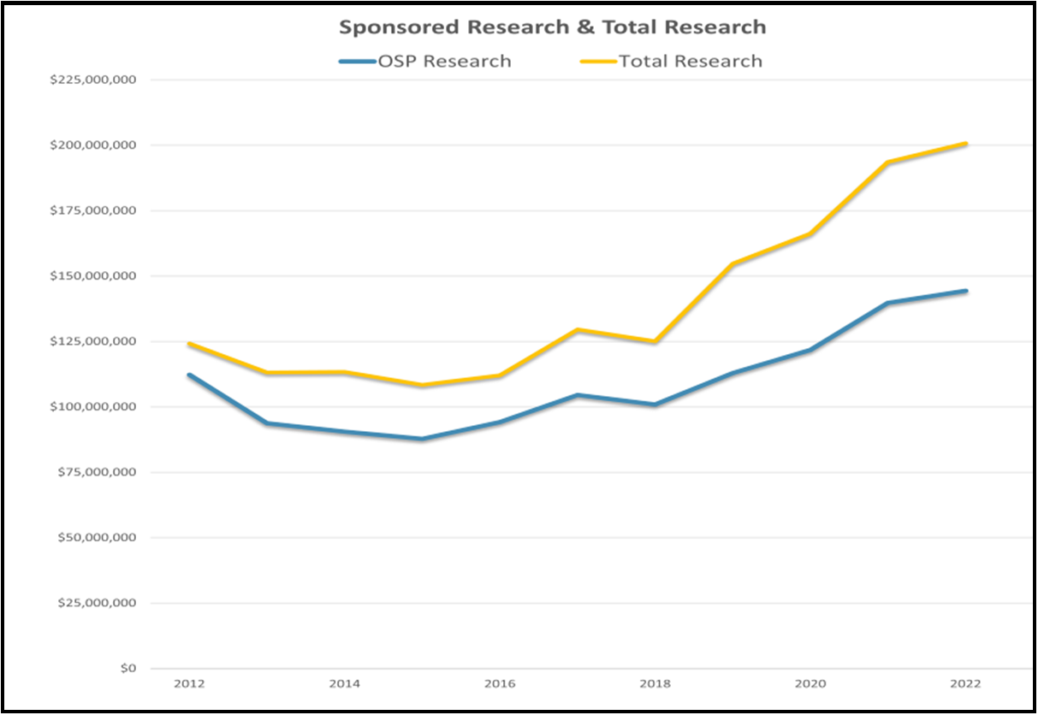
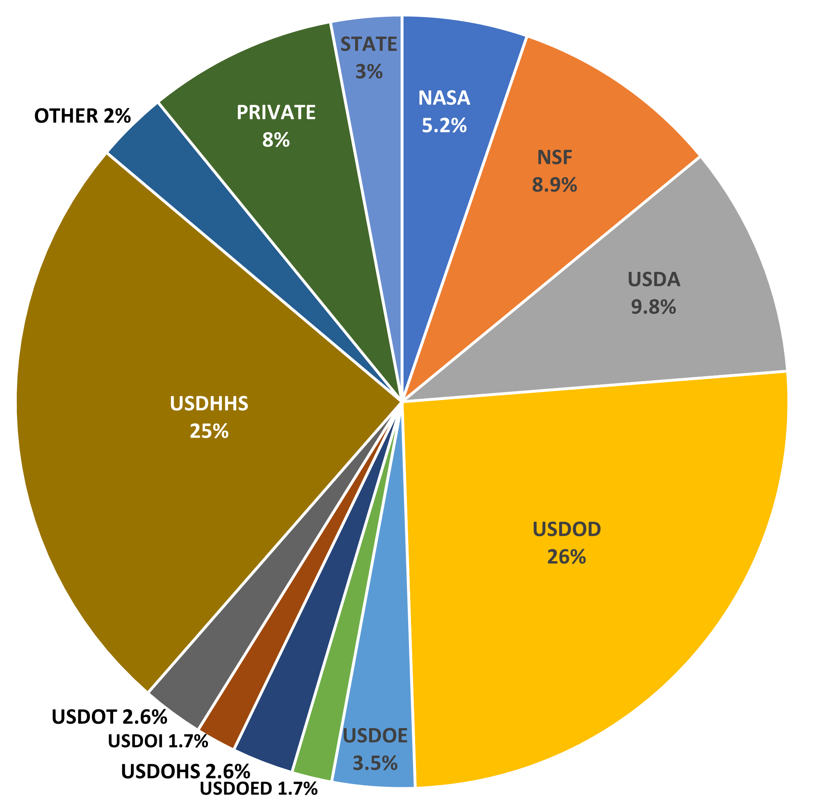
Top Research University
Top federal funding sponsor is Department of Defense, followed by DHHS, with increasing research funds from Departments of Energy and Homeland Security

Slide 4
How to do work with ARL
Models A & B
Partners Engaging with MSU Research Staff and/or Students
Faculty, staff and student conducted R&D
Both unclassified and classified research opportunities
Classified facility costs rolled into project budget (IDCs)
Contact ARL Program Development Staff to develop a SOW, space requirements, budget and plan
Model C
Partners Requiring Classified Space for Internal Purposes
Shared Services Agreement
Monthly occupancy fee
Occupants are encouraged to engage MSU students in research activities
Contact ARL Program Development Staff for information on space requirements, accreditation, access and other details
MSU as Prime – Model A MSU as Sub – Model B

